Slide 1
How to Help People in Need
Paul Coulter
www.livingleadership.org

Slide 2
www.livingleadership.org/elf-pastoral-care

Slide 4
Pastoral Care Foundations
1. The Urgent Need for Pastoral Care
Paul Coulter
www.livingleadership.org

Slide 5
Is pastoral care important in the modern mission field of Europe?

Slide 6
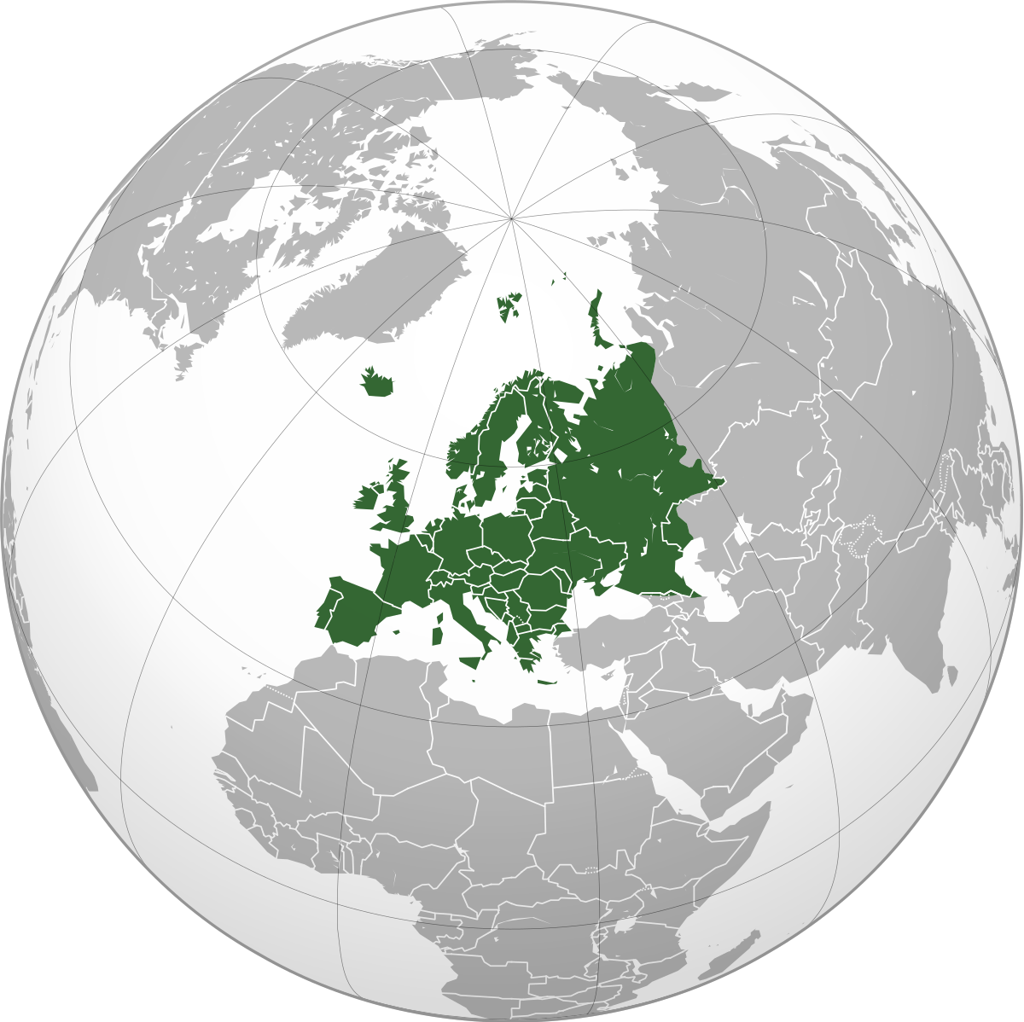
The needs of Europe
Energy / Climate
Relativism
Secularism
Mental health
War / Security
Expressive
individualism
Religious
pluralism
Finance / Trade

Slide 7
What is
Care
Pastoral
?

Slide 8
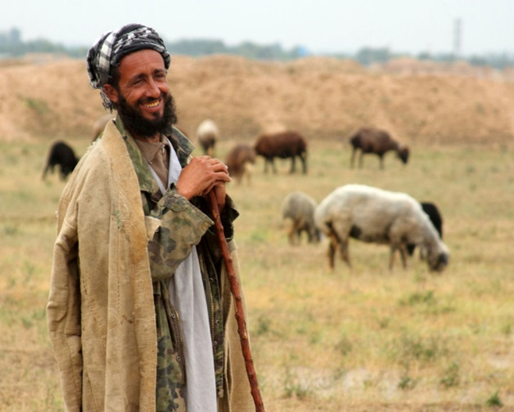
Pastoral
Shepherds of God’s people: protect, provide, gather and guide (Ezekiel 34; Psalm 23) under Christ, our Good Shepherd (John 10:1-18) and the Church’s Chief Shepherd (1 Peter 5:4)
Care
Cura animarum [prioritising souls]
Soul Care – sustaining and protecting soul life
Soul Cure – restoring and promoting soul health

Slide 9
Gospel-shaped pastoral care?
Gospel-shaped people
responding to gospel-shaped needs
with gospel-shaped help
Disciple-making in specific needs
The gospel defines needs, health and help

Slide 10
The Gospel
GOD RULES – creation is good and orderly
WE REBELLED – sinners with dignity and depravity
GOD REDEEMS – grace and truth in Christ
WE RESPOND – repentance and faith
GOD RESTORES – help and hope in community
FATHER
SON
SPIRIT

Slide 11
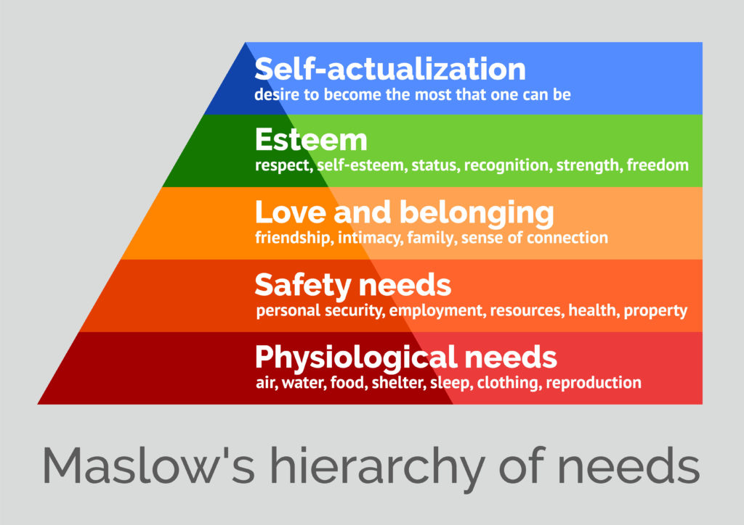
Gospel-shaped needs
actualisation of self through autonomous choices
salvation from sins through
denying self and following Christ

Slide 12
The Gospel and soul needs
MEANING What’s the point? Why did this happen to me?
GOD RULES – creation is good and orderly
IDENTITY Who am I? Why do I keep doing these things?
WE REBELLED – dignity and depravity
MORALITY Where can I go for justice? How can I have a good life?
GOD REDEEMS – grace and truth in Christ
SECURITY How can I be safe? Who truly loves me?
WE RESPOND – repentance and faith
DESTINY What is life’s goal? Where will I end up?
GOD RESTORES – help and hope in community

Slide 13
Gospel-shaped health (now & future)
Mental
Physical
Organ systems in harmony as God designed and bodies offered to God
Thoughts and emotions aligned with truth so we think and feel with Christ
Spiritual
Fearing, loving and
pleasing God
Social (relationships & roles)
Honouring and loving, submitting and leading under Christ in love for good

Slide 14
Gospel-shaped help
Supporting people through challenges to find inner healing
Helping people come to know Christ and grow in him

Slide 15
Spirit-led care
Sharing His loving agenda of leading others to Christ-likeness
Trusting in His complete power and constant presence
Knowing His work is in part now, but complete in the end
We help; He is the Helper (John 14:16)
We teach; He transforms (2 Corinthians 3-4)
We encourage; He assures (Romans 5:5; 8:15-17)
We pray; He intercedes perfectly (Romans 8:26-27)

Slide 17
Pastoral Care Foundations
2. Gospel-Shaped Help
Paul Coulter
www.livingleadership.org

Slide 18
Gospel-shaped help

Slide 19
SOUL CARE
Representing God to people
Presence
Provision
Speaking to people on behalf of God
Speaking to God on behalf of people
Instruction
Intercession
SOUL CURE

Slide 20
Presence
“a physical sign of the gracious presence of the triune God”
Dietrich Bonhoeffer (1954) Life Together, trans. by John W. Doberstein. San Francisco: HarperOne. p.20
Intentional – unhurried, undistracted, unshockable
Integral – body, words, emotions, silences, self-aware
Interactive – questions, feedback, summarising
Interpretive – discerningly identifying soul needs
Appropriate touch?

Slide 21
Provision
“it is part of the discipline of humility that we must not spare our hand where it can perform a service”
Dietrich Bonhoeffer (1954) Life Together, trans. by John W. Doberstein. San Francisco: HarperOne. p.99
Modelled by Christ, practised in Acts, commanded in epistles (e.g., 1 John 3 v17)
Integral mission of deeds and words
Roles of Church / State / Charities?
How long and what form?

Slide 22
Intercession
“spiritual love will speak to Christ about a brother more than to a brother about Christ”
Dietrich Bonhoeffer (1954) Life Together, trans. by John W. Doberstein. San Francisco: HarperOne. p.36
“Our Father” – joining Son & Spirit in God’s will
Specific petitions; Scriptural priorities
Changing us and involving us in God’s work
Bridging from listening to instruction

Slide 23
Instruction
“It is unchristian consciously to deprive another of the one decisive service we can render him”
Dietrich Bonhoeffer (1954) Life Together, trans. by John W. Doberstein. San Francisco: HarperOne. p.105
Reshaping stories around Christ
Exposing sin and encouraging faith(fulness)
God’s word versus our wisdom
Respecting conscience – not imposting

Slide 24
The challenge of instruction
Instruction is challenging :
Cultural – individual autonomy, self-actualisation, the ‘right’ not to be offended
Confidence – will I get it wrong or mishandle Scripture, and do I have the right?
Cost – will the relationship be lost and will it cause more harm than good?
Instruction is vital :
“Nothing can be more cruel than the tenderness that consigns another to his sin. Nothing can be more compassionate than the severe rebuke that calls a brother back from the path of sin.” Dietrich Bonhoeffer (1954) Life Together.
For even if I made you grieve with my letter, I do not regret it […]. For godly grief produces a repentance that leads to salvation without regret, whereas worldly grief produces death. 2 Corinthians 7:8-10

Slide 25
Instruction within integral care
“[Instruction is] beset with infinite perils
If it is not accompanied by worthy listening, how can it really be the right word for the other person?
If it is contradicted by one’s own lack of active helpfulness, how can it be a convincing and sincere word?
If it issues, not from a spirit of bearing and forbearing, but from impatience and the desire to force its acceptance, how can it be the liberating and healing word?”
Dietrich Bonhoeffer, Life Together, p.104-107
Presence
Provision
Patient &
prayerful

Slide 26
Scripture in pastoral care
Performative
Words expressing emotion & shaping faith – e.g., Psalms, prayers
Formative
Stories challenging the imagination – stabilising & subverting
Normative
The big gospel story calling to trust in God
Transformative
Authoritative truth changing us through repentance and faith

Slide 27
Scripture as Transformative
Commands, warnings, promises and principles to be trusted and obeyed
All Scripture is breathed out by God and profitable for teaching, for reproof, for correction, and for training in righteousness 2 Timothy 3:16
warn those who are idle and disruptive, encourage the disheartened, help the weak, be patient with everyone 1 Thessalonians 5:14
 | Right | Wrong
Beliefs | Teaching | Correction
Behaviour | Training | Reproof

Slide 29
Pastoral Care Foundations
3. Gospel-Shaped People
Paul Coulter
www.livingleadership.org

Slide 30
What qualities do you need to have to be an effective pastoral caregiver?

Slide 31
The qualities of a caregiver
Available to people in Christlike relationships and to the Spirit

Slide 32
Who is competent to care?
“After all has been said and done, what we have to offer is our authentic selves in relationship to others. What matters most, what transforms, is the influence of a humble, vulnerable witness to the truth. Henri Nouwen (2006) Spiritual Direction. New York: HarperOne. p.10.
we are the aroma of Christ to God among those who are being saved and among those who are perishing, to one a fragrance from death to death, to the other a fragrance from life to life. Who is sufficient for these things? For we are not, like so many, peddlers of God's word, but as men of sincerity, as commissioned by God, in the sight of God we speak in Christ. 2 Corinthians 2 v15-17

Slide 33
Pastoral Relationships
“Writing cheerful graffiti on the rocks in the valley of deep shadows is no substitute for companionship with the person who must walk in the darkness.” Eugene Peterson (1980) Five Smooth Stones. Grand Rapids: Eerdmans. p.36
SHOW them love provision
GO to them presence
KNOW their need listening & intercession
GROW with them guidance / instruction

Slide 34
The qualities of a caregiver
Available to people in Christlike relationships and to the Spirit
Believing the gospel and trusting in Christ (evaluating other ideas in light of the gospel)
Compassionate like our Father God

Slide 35
The problem with Empathy
Overwhelming – in crises, people need a reassuring presence
Misleading – “I know exactly how you are feeling”
Misdirecting – clouding judgement and feeding bias or neglect
Compassion feels with the other, but is strong and fair, and moves us to action

Slide 37
Pastoral Care Foundations
4. Creating Caring Communities
Paul Coulter
www.livingleadership.org

Slide 38
How can you make sure everyone is well cared for in your church?

Slide 39
Question 1 Who provides care?
What are the respective roles of:
All believers?
Some gifted and burdened to care?
Few ‘recognised shepherds’?
What training will caregivers have?
Who cares for the caregivers?

Slide 40
Levels of pastoral care
Community – ‘one anothering’ and intercession through normal ups and downs
Companionship – supportive presence and provision amidst extra challenges
Comfort – hearing stories, including confession, and assuring of gospel truth
Counsel – biblical instruction for specific issues in thinking, relationships and emotions
Coaching – a guide / mentor engaging over time for growth in Christ
ALL
More intensive
SOME
FEW

Slide 41
Question 2 How is care provided to everyone?
Reactive – responding to urgent needs (who can people contact and how can they mobilise others to help?)
Proactive – noticing when needs arise (e.g., visitation, small groups, pastoral care team)
Preventative – growing a caring community (teaching, prayer, modelling) including all in core practices (Acts 2 v42)

Slide 42
Church: a community of …
Love – intimacy and vulnerability, secure in God’s love
Faith – trusting acceptance of mutual contributions
“It is not the experience of Christian brotherhood, but solid and certain faith in brotherhood that holds us together. […] We are bound together by faith, not by experience.” Dietrich Bonhoeffer (1954) Life Together. San Francisco: HarperOne. p.39.
Hope – patient endurance through weakness and disappointment
“a healing community not because wounds are cured and pains are alleviated, but because wounds and pains become openings or occasions for a new vision. […] sharing weakness becomes a reminder to one and all of the coming strength.” Henri Nouwen (1994) The Wounded Healer. London: DLT. P.94.

Slide 43
Beware unrealistic expectations
Home is not always comfortable, and community is not always easy. In every community the healing of acceptance happens and deep betrayals take place. […] There is always someone in the community who betrays your trust or hands you over to something painful or unwanted. As soon as you have community, you have a problem.
Henri Nouwen (2006) Spiritual Direction. New York: HarperOne. p.113-114, 123-124

Slide 44
Question 3 What are the limits of care in the church?
Accountability to God and his shepherds
Boundaries to protect carers, cared for and church

Slide 45
Boundaries: what and why?
“intentional limits placed on thoughts, words, and deeds to safeguard the protection of persons and to guard and protect the integrity of the church’s identity and mission. ” Arden Mahlberg and Craig Nessan
Sheep among wolves – be innocent and wise (Matthew 10 v16)
We are all prone to temptation (1 Corinthians 10 v12)
The gospel of truth shapes sincere servants (2 Corinthians 1 v12)

Slide 46
Yes and No in boundaries
 | Cannot say … | Cannot hear …
… ‘No’ | Compliant Feels guilty and/or controlled by others; cannot set boundaries | Controlling Aggressively, or manipulatively, violates another’s boundaries
… ‘Yes’ | Uncaring Sets boundaries against the responsibility to love others | Unaccountable Sets boundaries against being accountable to others
Adapted from Cloud and Townsend (1992) Boundaries. Grand Rapids: Zondervan. p.61.

Slide 47
Can you identify any of the negative tendencies (inability to say or hear ‘yes’ or ‘no’ in yourself)? How can you grow in that area?

Slide 48
What boundaries?
Safeguarding (children and adults at risk)
Confidentiality (with limits )
Sexual / relational misconduct (power imbalance)
Financial misconduct (gifts / legacies)
Other abusive or manipulative behaviours
Dual relationships (what role are you playing now?)
Communication (factual, courteous, non-flirtatious)

Slide 49
Question 3 What are the limits of care in the church?
Accountability to God and his shepherds
Boundaries to protect carers, cared for and church
Can’t help (out of depth – if in doubt ask for advice)? Who can? (e.g., more experienced pastoral caregiver, pastor, professionals)

Slide 52
pastoral care that is holistic in its approach to people in need and consistently shaped by the gospel
pesiod.com
bit.ly/keepingcarepastoral

