Slide 1
Developing an online apologetics ministry
Bjørn Hinderaker
Notes:
Har betydning for synliggjøringstilleggene:
Skolenes eksistens.
Bevisst kristent perspektiv – helhstssyn .
På barna ,
verdi uavhengig av ytelse
respekt
Inspirere til læring og utvikling
Identitet – livssyn
Bevissthet om hva de tror på, påvirkning, valg
Kristen tro som sann – åpenhet ydmykhet respekt
Bavisst
På faget,
På Gud – åpen himmel,
På tro
Ansvar
Praktisk???
Aktiviteter signaliserer
Aktiviteter som former
Bønn og Guds ord?
Motivere skape nysgjerrighet
Spørre, Utforske
Signaliserer trygg tro
Se barna?
Tolerere forskjeller/ulikheter
Peke på Jesus
Ydmykhet
Takknemlighet
Nysgjerrighet
Agape - kjærlighet

Slide 2
The background story: The emergence of a Norwegian apologetics movement
A gradual development of an integrative strategy with 5 key elements:
A core group of leaders with
a shared evangelical commitment and
a united vision for apologetics,
with inspiration from international networks (L’Abri, UCCF, OCCA, ELF)

Slide 3
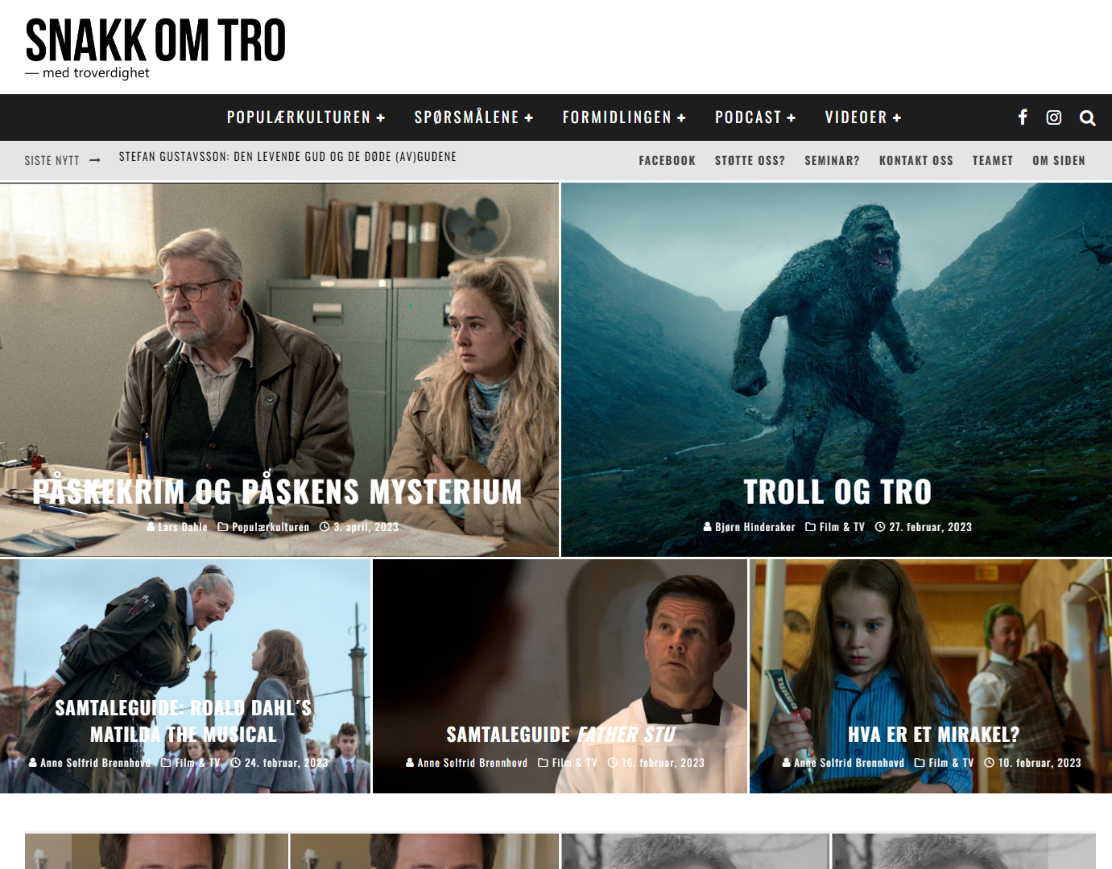
An integrative strategy with 5 key elements:
1. Higher education: Launching academic courses (2001):
Communication, Worldviews and Christian Apologetics programme
2. Communicating with and resourcing the wider Christian constituency:
Establishing Damaris Norway (2003)
“a strategic hub for networking, cultural apologetics, and community engagement. It offers worldview analysis of cultural stories and products, in order to develop resources for churches, schools and the wider society with double listening to the Word and the world as a characteristic feature.”

Slide 4
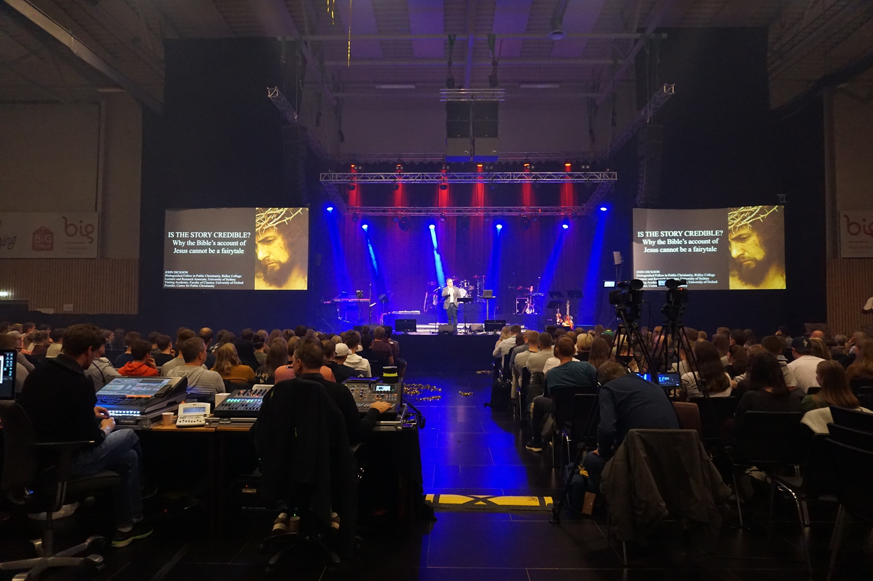
3. Academic research: Nordic apologetic journal Theofilos (2009)
(- academic journal in 2012 - open access 2020).
4. Annual national conference: The Veritas Conference (2013)
NLA and DN partnering with
NKSS (Norwegian IFES) and
Grimstad Bible School

Slide 5
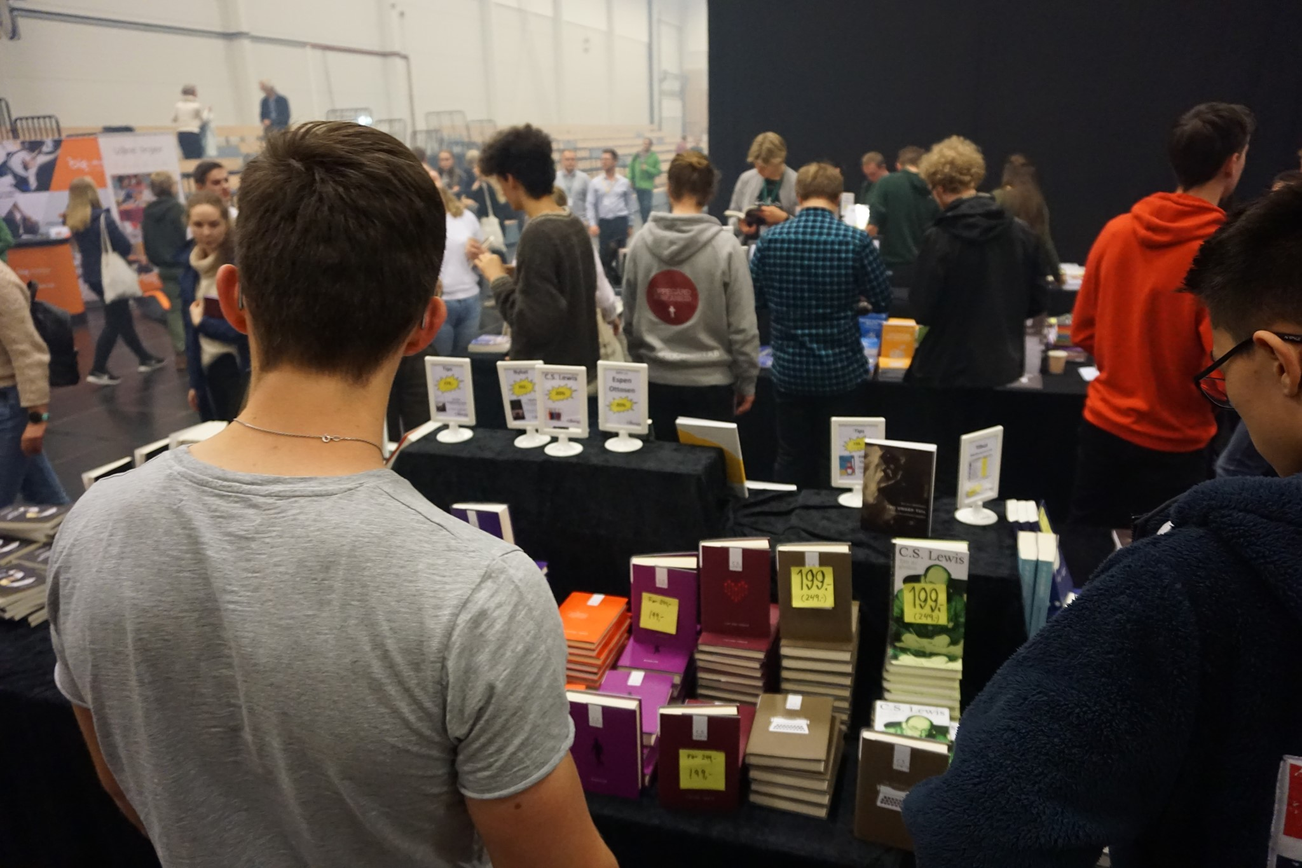
5. Partnership initiatives developing from the conference
2017: Veritas Imprint – for apologetic literature
2017: Veritas Seed-funding Initiative
2018: Veritas Public Events – seminars, lectures and debates
2018: Veritas Research Symposium – academic publication
2019: Veritas Norway Association:
“to coordinate and create synergies for Christian apologetic work in Norway, by sharing the Gospel, strengthening Christians and shaping culture»

Slide 6
Developing an online apologetics ministry: Key theological principles

Slide 7
Developing an online apologetics ministry: Key theological principles
Christian apologetics as integral to the mission of the church
as we ‘bear witness to Jesus Christ and all his teaching in every nation, in every sphere of society, and in the realm of ideas.”
(Cape Town Commitment 2011)

Slide 8
2. Christian apologetics is both

Slide 9
3. Christian apologetics has dual approach
‘closed fist’
argument/reason
‘open hand’
rhetoric/imagination

Slide 10
4. Christian apologetics has a key role in three contexts
pre- evangelism | persuasive evangelism | post- evangelism
Answering & Agenda-setting. | Commending & Clarifying. | Affirming & Equipping.

Slide 11
Developing our online apologetic ministry: Key features
A. Higher education: KL/CW as online hybrid education, - from online material to hybrid models with online interaction.
B. Resourcing the wider Christian constituency: Damaris Norway - from online archives to online podcasts, videos and interaction.
C. Academic research: Theofilos - from print through online archive to full open access.
D. Annual national conference:
- from only physical to online elements and curating the conference material online.
E. Partnership initiatives: - initiatives are supported and supplemented with online resources.

Slide 12
Application – and questions for reflection:
What is your apologetic calling, ministry and focus in view of the three contexts:
Pre-evangelism - Persuasive evangelism - Post-evangelism
Who are your potential apologetic partners?
maybe with supplementary callings and arenas?
What could be your integrative strategy with a
sharp focus,
broad spectrum and
extensive reach
How can you start building a community of apologetic practitioners
with mutual trust, encouragement, challenging and spiritual nourishment?

