Slide 1
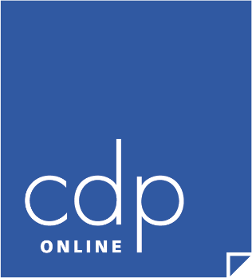
ELF 2021 Funding Your Vision – Part I
By Jerry Twombly, M.Div. & Gregory Long, M.A.

Slide 2
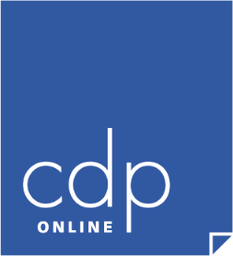
CDP Definition of Development
The things we do to build
rational relationships with others…
Jerry Twombly
CDP Founder & Developer

Slide 3
The 8 Areas of Development
Fundraising
Recruitment
Retention
Public Relations
Database Management
Strategic Planning
Organization
Outcomes

Slide 4
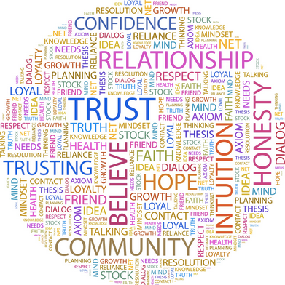
The Definition of Development
“Development represents the things we do to build rational relationships with others.”
Characteristics of Relationships
Words we Use
The Difference Between
Relationships and Arrangements

Slide 5
The “Work” of Development
The Work of Developing an Organization
It’s not difficult
In fact, it’s easy
We all have experience
Development is like. . .
Falling in Love
Building a Deep Friendship
The Time it Takes
The Process

Slide 6
The Relationship Continuum
Exposure Event
Subsequent events in short time frame

Slide 7
The Relationship Continuum
I and Me
become
Us and We
Pronouns change
Emotion grows deeper
Rational behavior grows stronger

Slide 8
Funding Your Vision
Five Steps for Relational Solicitation
Identifying
Qualifying
Cultivating
Soliciting
Sustaining

Slide 9
Five Steps for Solicitation
Identifying
Qualifying
Cultivating
Soliciting
Sustaining

Slide 10
Relational Solicitation Identifying
“We don’t know enough people!”
“Our database is too small.”
Many ministries and organizations believe they are limited by geography, staff, budget, etc.
Many believe they just don’t know people with “money.”

Slide 11
Relational Solicitation Identifying
With today’s technology, there is almost no limit to the people you can reach and invite to partner with your ministry.
Linkage
Relational Linkage
Created Linkage

Slide 12
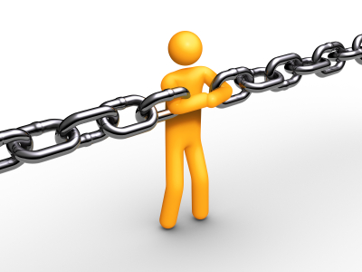
Relational Solicitation Identifying
Linkage
Those closest to your ministry are most likely to partner with you.
Relational Linkage – people who have some type of relationship with you.

Slide 13
Relational Solicitation Identifying
Relational Linkage
People who have some type of obvious or natural relationship with you.
What are the groups already connected to your Vision?
Schools – Parents, Grandparents, Alumni
Pregnancy Care – Churches, Local Hospital and Medical Practitioners
Church – Members, Worshipers, Sunday School, Weekday Ministries, etc.

Slide 14
Relational Solicitation Identifying
Relational Linkage
People who have some type of obvious or natural relationship with you.
Vendors & Suppliers (print shops, office supplies)
Media (local newspaper, magazines, radio)
Technicians (HVAC, plumbing)

Slide 15
Relational Solicitation Identifying
Created Linkage
Ways to build connections with people who do not have an obvious or natural relationship with you.
Potential partners and donors
Advocates for your mission
Influential individuals
Like-minded organizations for collaboration

Slide 16
Solicitation - Lesson 3 Identifying
Affinity Groups - Relational Linkage
- Created Linkage
Share Core Values (although you may not know it)
Provide an opportunity to share your work & mission with them
Exposure opportunity (recall Relationship Continuum)

Slide 17
Ministry Project
Identify three (3) affinity groups for your ministry. These can be either Relational or Created.
List six (6) individuals that you wish were part of your organization, but are not currently.

Slide 18
Five Steps for Solicitation
Identifying
Qualifying
Cultivating
Soliciting
Sustaining

Slide 19
Relational Solicitation Qualifying
Potentially, anyone in the world could be in relationship with your ministry.
Everyone in relationship with your ministry is in a different stage – some are closer and more engaged than others. Can you think of a few examples?
How do we let this steer and guide our communication and Solicitation strategies to encourage people to partner with us?

Slide 20
Relational Solicitation Qualifying
Methods to Qualify:
Linkage (type of relationship)
Wealth
Profession
Interests
Special Needs

Slide 21
Relational Solicitation Qualifying
Within your database, consider building models that incorporate the AID Model
Attend - Involve - Donate
If they are not in your database – they do not count!

Slide 22
Relational Solicitation Qualifying
A-I-D
A
I
D
Attend
Involve
Donate

Slide 23
Relational Solicitation Qualifying
You’ll need a definition for each as it best matches with your ministry.
Attend – Heard about Mission
Involve – Volunteered or served without hearing Mission
Adjust best for you!

Slide 24
Relational Solicitation Database Strategies and Tips
1
2
1
3

Slide 25
Relational Solicitation Qualifying
A-B-C-D
D
No AID
C
1 of 3 AID
B
2 of 3 AID
A
3 of 3 AID
(AID: Attend, Involve, Donate)

Slide 26
Relational Solicitation Qualifying
A-B-C-D
D
No AID
C
1 of 3 AID
Andrew & Vivian
B
2 of 3 AID
Elaine & Greg
A
3 of 3 AID
Sue & Jerry
(AID: Attend, Involve, Donate)

Slide 27
Relational Solicitation Qualifying
A-B-C-D
D
No AID
C
1 of 3 AID
B
2 of 3 AID
A
3 of 3 AID
(AID: Attend, Involve, Donate)

Slide 28
Relational Solicitation Qualifying
A-B-C-D
D
No AID
10%
C
1 of 3 AID
30%
B
2 of 3 AID
60%
A
3 of 3 AID
90%
(AID: Attend, Involve, Donate)

Slide 29
Relational Solicitation Qualifying
There needs to be a way to identify and track where people are in relationship with your ministry.
No matter how basic or complicated your system might be (spreadsheet, commercial database, index cards, etc.).
We need to know an individual's connection to us.

Slide 30
Qualifying - Ministry Projects
Project #1
Reflection – Think about ministries you personally support. Where are you in relationship to these groups?
A – I – D
A – B – C – D

Slide 31
Qualifying - Ministry Projects
Project #2
Think of 3-5 people in your ministry who would be classified as an “A” or “B” entry in your database system.
Start a document, describe how they connected with your ministry. What is their journey and relationship with you?
How can this be replicated for others?

Slide 32
ELF 2021 Funding Your Vision – Part I
By Jerry Twombly, M.Div. & Gregory Long, M.A.

