Slide 1
HOW SHOULD THE CHURCH THINK ABOUT THE STATE? Dr David McIlroy Barrister and Theologian, Associate Tutor, Spurgeon’s College Adjunct Professor in Law, University of Notre Dame www.theologyoflaw.org

Slide 2
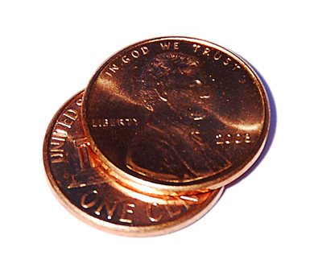
Christ is Lord of all of Life
There are not two spheres: one which belongs to God and one which belongs to government. Everything belongs to God but God has given government authority over some things (see Matthew 22:15-22: everything is God’s, some things are Caesar’s).

Slide 3
GOVERNMENT GETS ITS AUTHORITY FROM CHRIST
“All authority in heaven and on earth has been given to me. Therefore go and make disciples of all nations, baptizing them in the name of the Father and of the Son and of the Holy Spirit, and teaching them to obey everything I have commanded you. And surely I am with you always, to the very end of the age.” (Matthew 28:18-20).

Slide 4
THE AUTHORITY OF GOVERNMENT
The context for government’s authority is God’s call that we are to love one another (Rom. 12:10, 14; 13:8)
“It is mine to avenge, I will repay” (Rom. 12:19)
Jesus will deliver the Final Judgment, when everything will be known (Rom. 2:16) and all wrongs will be righted (Rev. 6:10)
The need for judgment before the Lord comes is limited (1 Cor. 4:5)
Governments have authority to punish wrongdoing (Rom. 13:4) and to commend good (Rom. 13:3)
Governments have authority to collect taxes (Rom. 13:7)

Slide 5
THE CHURCH IS CALLED TO BE A PUBLIC INSTITUTION
Faith in Christ is not meant to be kept private
The public square is not meant to be under the control of government
The Church’s involvement in social and political life is an act of witness to the coming of the Kingdom of God

Slide 6
THE MISSION OF THE CHURCH TO GOVERNMENT
Government is accountable
Government is limited
Government’s primary calling is to do justice
Government is there to serve all, especially the weakest, the disadvantaged, and those without the relational networks to cope

Slide 7
THE RELATIONSHIP BETWEEN THE CHURCH AND GOVERNMENT
The Church is not meant to be a department of government
Christians should be faithful, responsible, critical and engaged citizens
In insisting on its own freedoms, the Church holds open a space for other organizations to be active in public life
In speaking out for the destitute, the Church reminds government of the needs of the powerless (Prov. 31:8)

