Slide 1
Prodigal Servants and Unfaithful Fathers? Six Rules on How (not) to Read and Apply the Parables of Jesus
The European Leadership Forum, Wisla, Poland
May 21, 2023
Vesa Ollilainen

Slide 2
Introduction: New perspectives on old stories?
The confusing impact of parable scholarship: One point of comparison or polyvalent parables? Self-explanatory or elusive stories? Informative or performative narratives?
The veiling impact of Bible reading and preaching: well-known, worn out, thoroughly studied parables?
Beware: the rules may provoke you. Accept that as a challenge to think afresh about the parables.

Slide 3
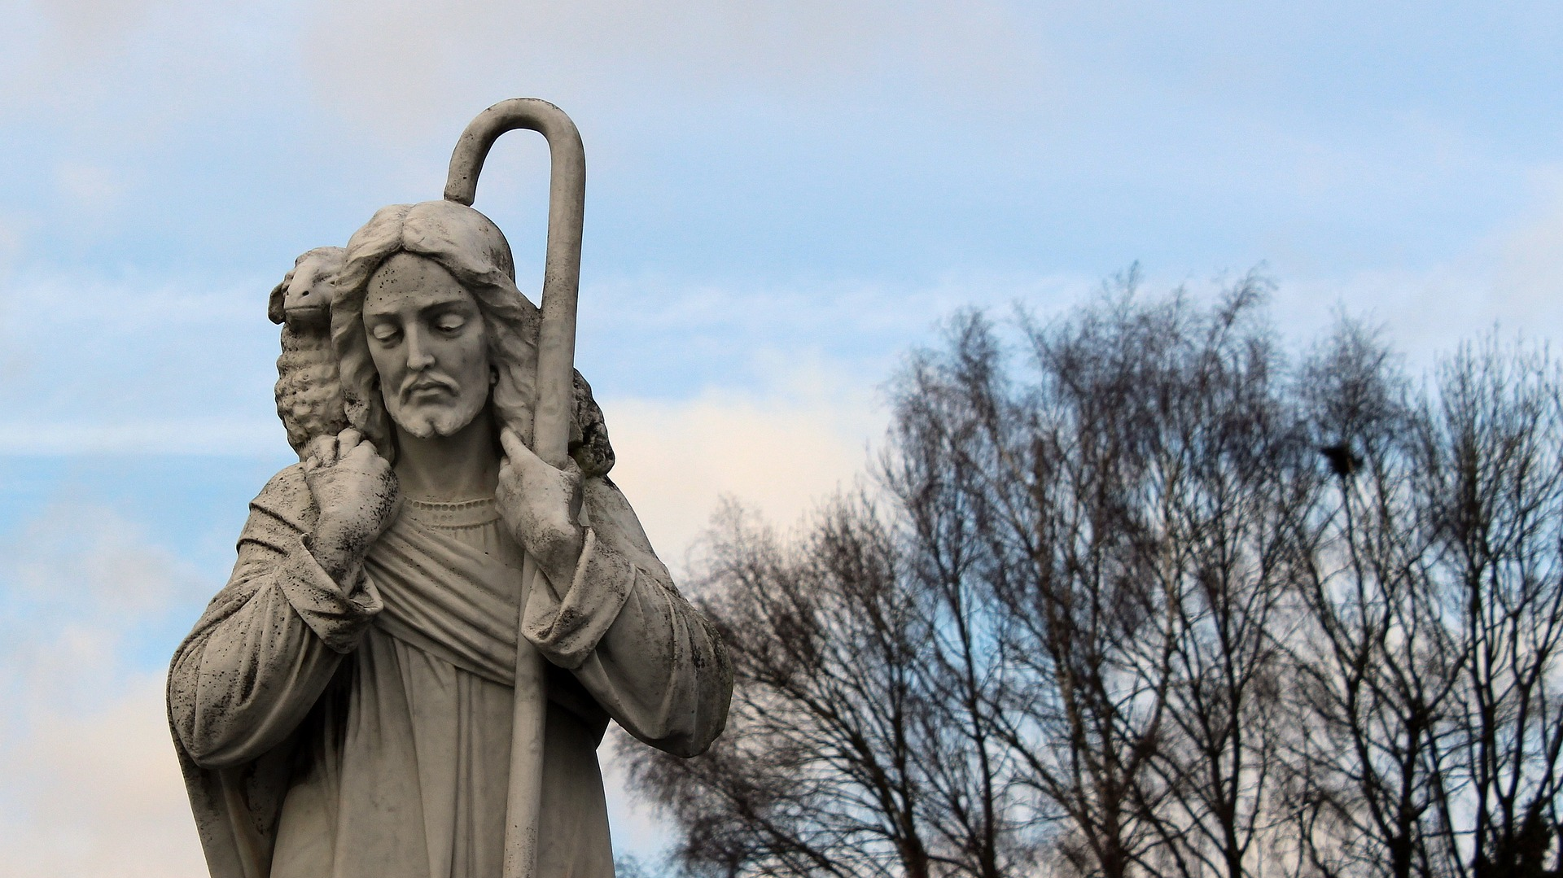
Rule 1: Acknowledge your assumptions about the parables.
A man has a hundred sheep. When he loses one of them, he leaves the ninety-nine in the open country, and goes after the one that is lost, until he finds it. And when he has found it, he lays it on his shoulders, rejoicing. And when he comes home, he calls together his friends and his neighbors, saying to them, ‘Rejoice with me, for I have found my sheep that was lost.’ (cf. Luke 15:4-7)
Now the tax collectors and sinners were all drawing near to hear him. And the Pharisees and the scribes grumbled, saying, “This man receives sinners and eats with them.” So he told them this parable: “What man of you…” (Luke 15:1-3)

Slide 4
Rule 1: Acknowledge your assumptions about the parables.
But while he was still a long way off, his father saw him and felt compassion, and ran and embraced him and kissed him. But the father said to his servants, ‘Bring quickly the best robe, and put it on him, and put za ring on his hand, and shoes on his feet. And bring the fattened calf and kill it, and let us eat and celebrate. For this my son was dead, and is alive again; he was lost, and is found.’ And they began to celebrate. (cf. Luke 15:20, 22-24)
And the son said to him, ‘Father, I have sinned against heaven and before you. I am no longer worthy to be called your son.’ (Luke 15:21)
Now the tax collectors and sinners were all drawing near to hear him. And the Pharisees and the scribes grumbled, saying, “This man receives sinners and eats with them.” (Luke 15:1-3)

Slide 5
Rule 2: Respect the context(s).
The parable of the Lost Sheep (Luke 15:4-7)
I am the good shepherd. The good shepherd lays down his life for the sheep. He who is a hired hand and not a shepherd, who does not own the sheep, sees the wolf coming and leaves the sheep and flees, and the wolf snatches them and scatters them. He flees because he is a hired hand and cares nothing for the sheep. I am the good shepherd. (John 10:11-14)
Now the tax collectors and sinners were all drawing near to hear him. And the Pharisees and the scribes grumbled, saying, “This man receives sinners and eats with them.” So he told them this parable: “What man of you…” (Luke 15:1-3)

Slide 6
Rule 3: Beware of external information.
Leave ninety-nine sheep in the open country? (Luke 15:4)
Ten silver coins? (Luke 15:8)
The father divided his property between his sons? (Luke 15:12)
A priest passed by on the other side? (Luke 10:31)
The innkeeper? (Luke 10:35)

Slide 7
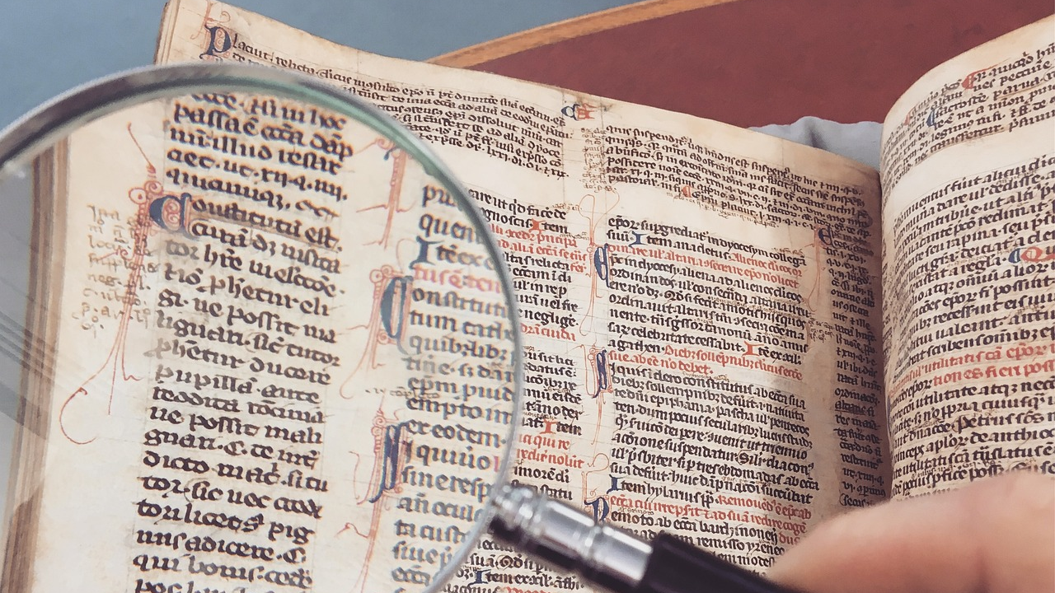
Rule 4: Find the emphasis of the parable – and stick to it.
The parables of the lost sheep and the lost coin: “Just so, I tell you, there will be more joy in heaven over one sinner who repents than over ninety-nine righteous persons who need no repentance. - - Just so, I tell you, there is joy before the angels of God over one sinner who repents.” (vv. 7, 10.)
The parable of the prodigal son (Luke 15:11-32): “It was fitting to celebrate and be glad, for this your brother was dead, and is alive; he was lost, and is found.” (v. 32)

Slide 8
Rule 5: Theologizing tends to mistreat the parables.
But while he was still a long way off, his father saw him and felt compassion, and ran and embraced him and kissed him. - - “Bring quickly the best robe, and put it on him, and put a ring on his hand, and shoes on his feet.” (Luke 15:20, 22)
The rich man also died and was buried, and in Hades, being in torment, he lifted up his eyes and saw Abraham far off and Lazarus at his side. (Luke 16:22-23)
But when the king came in to look at the guests, he saw there a man who had no wedding garment. And he said to him, ‘Friend, how did you get in here without a wedding garment?’ And he was speechless. (Matt. 22:11-12)

Slide 9
Rule 6: Look beyond the parables for Jesus the parable teller.
Moving from the shepherd who carries a sheep (Luke 15:4-7) to Jesus who has come to seek and to save the lost (Luke 19:10).
Moving from the king who forgives his servant his huge monetary debt to God who forgives sinners their immense debt of sins.
Moving from a father who runs to his son to God who in Christ enters his creation.

Slide 10
Questions?

Slide 11
Group discussion and application
Share your thoughts and feelings abouut the seminar. Insights? Points of agreement? Doubts? Unclarities?
How do you think you in the future will make use of the rule. Try to be specific.
Read the parable of the Great Banquet (Luke 14:15-24). Then discuss two issues:
What is your impression of how is the parable often or commonly interpreted and applied? How do you read the parables
How do the six rules for parable interpretation and application affect these common readings (and your reading) of the parable?

