Slide 2
Evaluating Your Church
Setting the Stage for God to Work

Slide 4
I. It takes FOCUS

Slide 6
START of Jesus’ Ministry

Slide 7
START of Jesus’ Ministry
MATTHEW 4:19
Follow me,” he told them, “and I will make you fish for people.”

Slide 9
MIDDLE of Jesus’ Ministry

Slide 10
MIDDLE of Jesus’ Ministry
LUKE 19:10
“For the Son of Man has come to seek and to save the lost.”

Slide 12
END of Jesus’ Ministry

Slide 13
END of Jesus’ Ministry
MATTHEW 28:19a
“Go, therefore, and make disciples of all nations . . .”

Slide 15
“. . . you will be my witnesses in Jerusalem, in all Judea and Samaria, and to the ends of the earth.”
ACTS 1:8b

Slide 17
CATCHING people
SEEKING people
SAVING people
MAKING DISCIPLES of people
WITNESSING further and farther to people

Slide 19
II. It takes FEEDING

Slide 21
Be diligent to present yourself to God as one approved, a worker who doesn’t need to be ashamed, correctly teaching the word of truth.
2 TIMOTHY 2:15

Slide 23
I solemnly charge you before God and Christ Jesus, who is going to judge the living and the dead, and because of his appearing and his kingdom: ²Preach the word; be ready in season and out of season; correct, rebuke, and encourage with great patience and teaching.
2 TIMOTHY 4:1-2

Slide 25
III. It takes FREEDOM

Slide 27
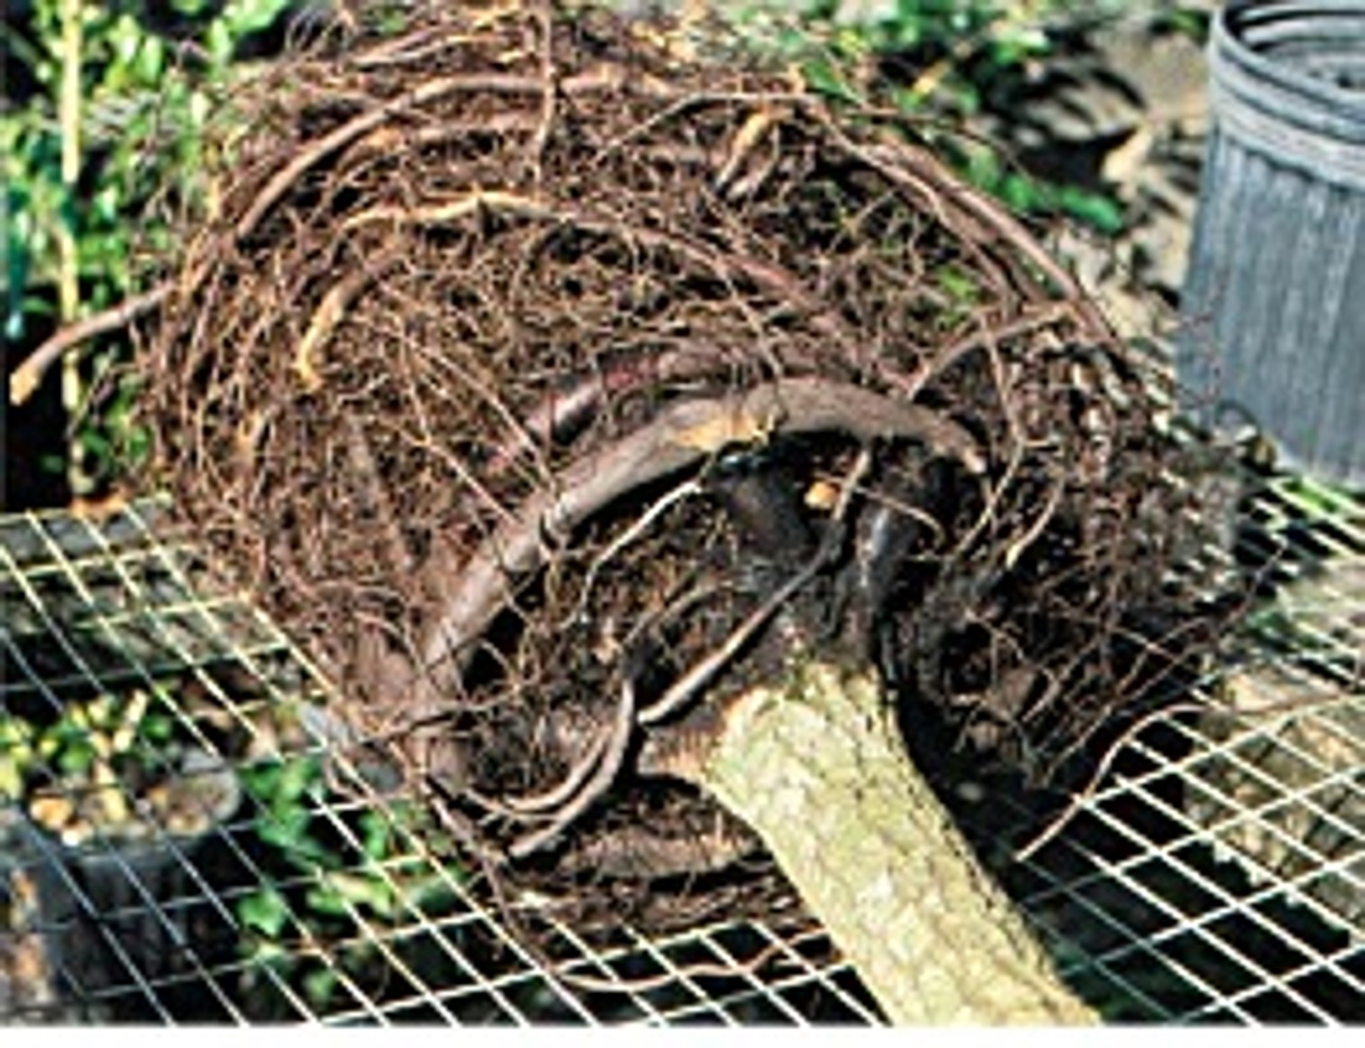

Slide 29
⁶ He answered them, “Isaiah prophesied correctly about you hypocrites, as it is written: This people honors me with their lips, but their heart is far from me. ⁷ They worship me in vain, teaching as doctrines human commands. ⁸ Abandoning the command of God, you hold on to human tradition.”
MARK 7:6-8

Slide 31
7 LAST WORDS OF A DYING CHURCH
“We never did it that way before.”
RALPH WEBSTER NEIGHBOUR

Slide 33
THINK OUTSIDE the BOX
BUT INSIDE the BIBLE

Slide 35
¹⁹ Although I am free from all and not anyone’s slave, I have made myself a slave to everyone, in order to win more people. ²⁰ To the Jews I became like a Jew, to win Jews; to those under the law, like one under the law—though I myself am not under the law—to win those under the law.
1 CORINTHIANS 9:19-22

Slide 36
²¹ To those who are without the law, like one without the law—though I am not without God’s law but under the law of Christ—to win those without the law. ²² To the weak I became weak, in order to win the weak. I have become all things to all people, so that I may by every possible means save some.”
1 CORINTHIANS 9:19-22

Slide 38
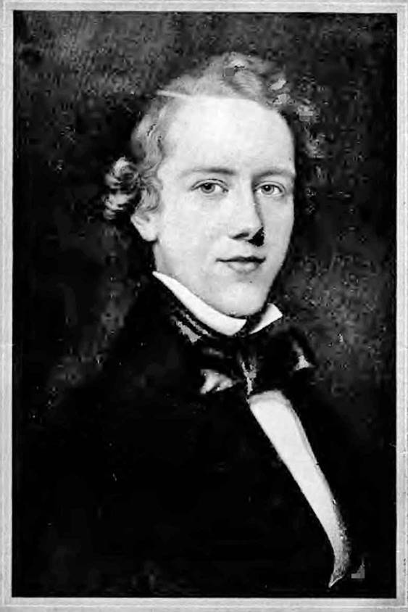

Slide 39
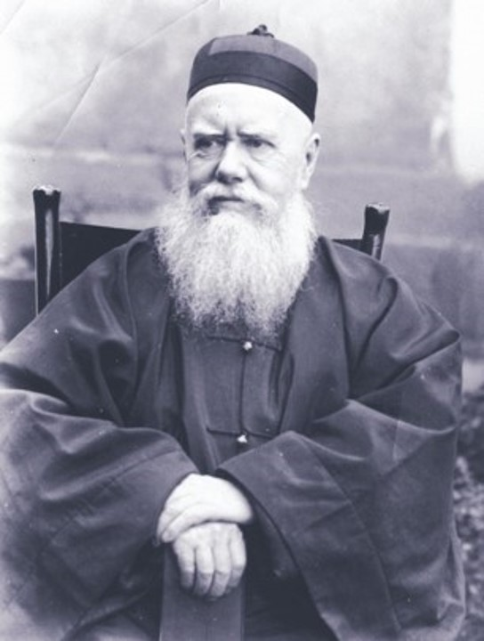

Slide 41
WHEN HUDSON TAYLOR DIED
18,000 converts traced to his China Inland Mission
300 stations of work, 20 in unevangelized areas
700 Chinese workers taking the gospel
125 schools started
849 missionaries in all 18 provinces, up from a few dozen
*Underground Chinese Church is Thriving today!!

Slide 43
IV. It takes FEARLESSNESS

Slide 45
“Only person who likes change is a wet baby.”
MARK TWAIN

Slide 47
“There is no job quite like the pastorate where you can displease so many of God’s people while pleasing Him.”
JIM LYTLE

Slide 49
The fear of mankind is a snare, but the one who trusts in the LORD is protected.
PROVERBS 29:25

Slide 51
For it is said, “His letters are weighty and powerful, but his physical presence is weak and his public speaking amounts to nothing.”
2 CORINTHIANS 10:10

Slide 53
For God has not given us a spirit of fear, but one of power, love, and sound judgment.
2 TIMOTHY 1:7

Slide 55
V. It takes FELEGATION

Slide 57
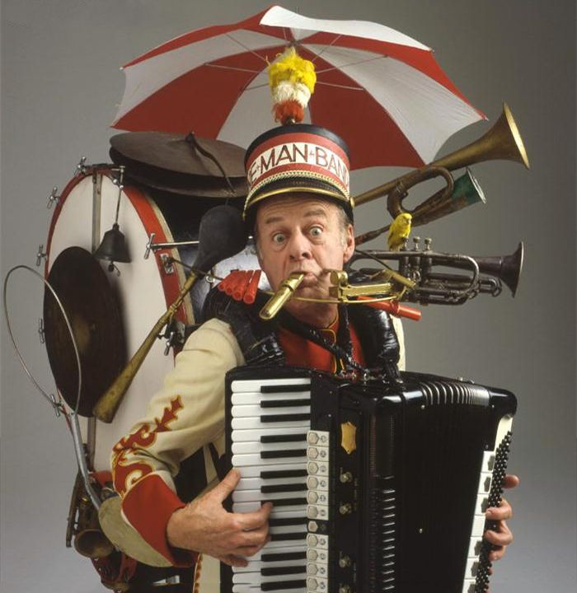

Slide 59
CHARACTER --- Godly
COMPETENCY --- Gifted
COMMITMENT --- Guarantee Follow Through
CAPACITY --- Growth Potential
CHEMISTRY --- Great Fit
CALLING --- God’s Hand Upon Them
COMMUNICATION --- Good With People
COURAGE --- Got Guts

Slide 60
CHARACTER --- Godly
COMPETENCY --- Gifted
COMMITMENT --- Guarantee Follow Through
CAPACITY --- Growth Potential
CHEMISTRY --- Great Fit
CALLING --- God’s Hand Upon Them
COMMUNICATION --- Good With People
COURAGE --- Got Guts
CALM
COMPASSION/CARE
CREATIVITY
COMEDY

Slide 62
¹¹ And he himself gave some to be apostles, some prophets, some evangelists, some pastors and teachers, ¹² to equip the saints for the work of ministry, to build up the body of Christ . . .
EPHESIANS 4:11-12

Slide 64
¹⁷ “What you’re doing is not good,” Moses’s father-in-law said to him. ¹⁸ “You will certainly wear out both yourself and these people who are with you, because the task is too heavy for you. You can’t do it alone.”
EXODUS 18:17-18

Slide 66
VI. It takes FELLOWSHIP

Slide 68
⁴² They devoted themselves to the apostles’ teaching, to the fellowship, to the breaking of bread, and to prayer. ⁴³ Everyone was filled with awe, and many wonders and signs were being performed through the apostles.
ACTS 2:42-45

Slide 69
⁴⁴ Now all the believers were together and held all things in common. ⁴⁵ They sold their possessions and property and distributed the proceeds to all, as any had need.
ACTS 2:42-45

Slide 71
³⁴ “I give you a new command: Love one another. Just as I have loved you, you are also to love one another. ³⁵ By this everyone will know that you are my disciples, if you love one another.”
JOHN 13:34-35

Slide 73
⁴⁶ Every day they devoted themselves to meeting together in the temple, and broke bread from house to house. They ate their food with joyful and sincere hearts, ⁴⁷ praising God and enjoying the favor of all the people. Every day the Lord added to their number those who were being saved.
ACTS 2:46-47

Slide 75
Rejoice in the Lord always. I will say it again: Rejoice!
PHILIPPIANS 4:4

Slide 77
“. . . Do not grieve, because the joy of the Lord is your strength.”
NEHEMIAH 8:10b

Slide 79
VII. It takes FERVENCY

Slide 81
WORK like EVERYTHING DEPENDS on
YOU
PRAY like EVERYTHING DEPENDS on
GOD

Slide 83
. . . The prayer of a righteous person is very powerful in its effect. ¹⁷ Elijah was a human being as we are, and he prayed earnestly that it would not rain, and for three years and six months it did not rain on the land. ¹⁸ Then he prayed again, and the sky gave rain and the land produced its fruit.
JAMES 5:16b-18

Slide 85
Pray also for me, that the message may be given to me when I open my mouth to make known with boldness the mystery of the gospel . . . Pray that I might be bold enough to speak about it as I should.
EPHESIANS 6:19, 20b

Slide 87
“Satan dreads nothing but prayer. His one concern is to keep the saints from praying. He fears nothing from prayerless studies, prayerless work, prayerless religion. He laughs at our toil, mocks our wisdom but he trembles when we pray.”
SAMUEL CHADWICK

Slide 89
EVALUATING OUR CHURCHES
It takes . . .
FOCUS
FEEDING
FREEDOM
FEARLESSNESS
FELEGATION
FELLOWSHIP
FERVENCY

Slide 91
Evaluating Your Church
Setting the Stage for God to Work

