Slide 2
TEN ABSOLUTELY ESSENTIAL LESSONS TO RISE TO THE NEXT LEVEL OF MINISTRY LEADERSHIP

Slide 4
EXODUS 18:13-18
¹³ The next day Moses sat down to judge the
people, and they stood around Moses from
morning until evening.
¹⁴ When Moses’s father-in-law saw everything
he was doing for them he asked, “What is this
you’re doing for the people? Why are you alone sitting as judge, while all the people stand
around you from morning until evening?”

Slide 5
¹⁵ Moses replied to his father-in-law, “Because the people come to me to inquire of God. ¹⁶ Whenever they have a dispute, it comes to me, and I make a decision between one man and another. I teach them God’s statutes and laws.”
EXODUS 18:13-18

Slide 6
¹⁷ “What you’re doing is not good,” Moses’s father-in-law said to him. ¹⁸ “You will certainly wear out both yourself and these people who are with you, because the task is too heavy for you. You can’t do it alone.
EXODUS 18:13-18

Slide 8
LISTEN to OUTSIDE
OBJECTIVE OPINIONS

Slide 10
FRESH PERSPECTIVES can be
LIFE CHANGING

Slide 12
WE ALL HAVE BLIND SPOTS

Slide 14
FLASH AT DMV

Slide 16
GET OUT OF MINISTRY RUTS
AND LISTEN TO WISDOM

Slide 18
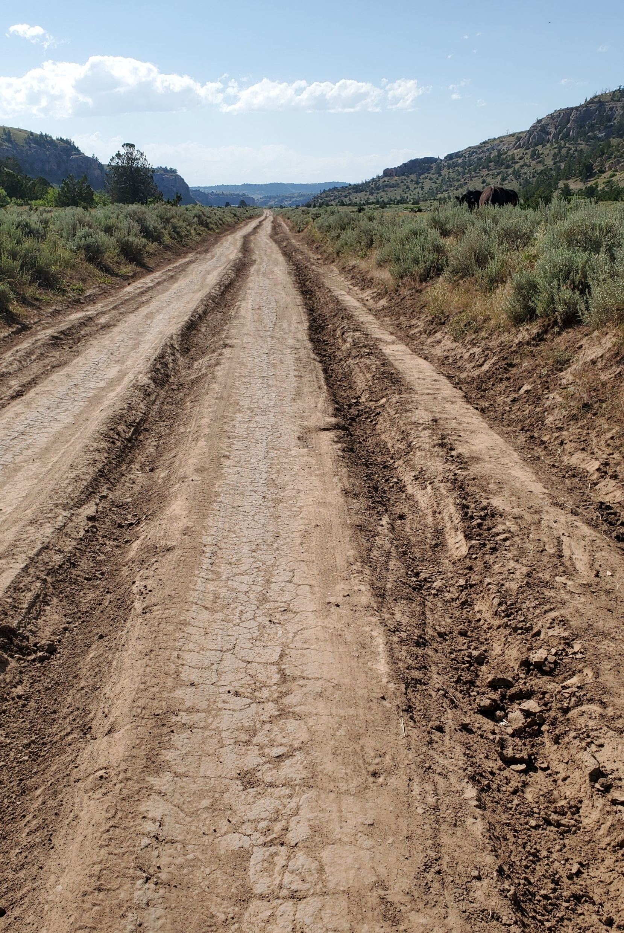

Slide 20
ECCLESIASTES 4:6
Better one handful with rest than two handfuls with effort and a pursuit of
the wind.

Slide 22
PSALM 127:2
In vain you get up early and stay up late,
working hard to have enough food—yes, he gives sleep to the one he loves.

Slide 24
LISTEN to “WHAT” and “WHY” QUESTIONS

Slide 26
II. EVERYTHING SHOULDN’T
REVOLVE AROUND YOU

Slide 28
EXODUS 18:15-16
¹⁵ Moses replied to his father-in-law, “Because the people come to me to inquire of God. ¹⁶ Whenever they have a dispute, it comes to me, and I make a decision between one man and another. I teach them God’s statutes and laws.”

Slide 30
HAVE EARS TO HEAR

Slide 32
PROVERBS 12:15
A fool’s way is right in his own eyes,
but whoever listens to counsel is wise.

Slide 34
“God buries His workmen but
carries on His work.”
Charles Wesley

Slide 36
TOO MANY --- I’s and ME’s
NOT ENOUGH --- US’s and WE’s

Slide 40
TEN ESSENTIAL LESSONS TO RISE TO THE NEXT LEVEL OF MINISTRY LEADERSHIP End Section 1

Slide 42
TEN ESSENTIAL LESSONS TO RISE TO THE NEXT LEVEL OF MINISTRY LEADERSHIP Start Section 2

Slide 44
III. THERE’S ALWAYS ROOM for IMPROVEMENT

Slide 46
EXODUS 18:17-18a
¹⁷ “What you’re doing is not good,” Moses’s father-in-law said to him. ¹⁸ “You will certainly wear out both yourself and these people who are with you, because the task is too heavy for you.

Slide 48
DISTINGUISH WHAT IS and IS NOT GOOD

Slide 50
BE WILLING to CHANGE
IMPROVE
TRY SOMETHING NEW

Slide 52
UNDERSTAND THE CONSEQUENCES

Slide 54
IV. STOP TRYING TO DO IT ALONE

Slide 56
ECCLESIASTES 4:9-12
⁹ Two are better than one because they have a good reward for their efforts. ¹⁰ For if either falls, his companion can lift him up; but pity the one who falls without another to lift him up. ¹¹ Also, if two lie down together, they can keep warm; but how can one person alone keep warm? ¹² And if someone overpowers one person, two can resist him. A cord of three strands is not easily broken.

Slide 58
TEN ESSENTIAL LESSONS TO RISE TO THE NEXT LEVEL OF MINISTRY LEADERSHIP End Section 2

Slide 60
TEN ESSENTIAL LESSONS TO RISE TO THE NEXT LEVEL OF MINISTRY LEADERSHIP Start Section 3

Slide 62
EXODUS 18:19-23
¹⁹ Now listen to me; I will give you some advice, and God be with you. You be the one to represent the people before God and bring their cases to him. ²⁰ Instruct them about the statutes and laws, and teach them the way to live and what they must do. ²¹ But you should select from all the people able men, God-fearing, trustworthy, and hating dishonest profit. Place them over the people as commanders of thousands, hundreds, fifties, and tens.

Slide 63
²² They should judge the people at all times. Then
they can bring you every major case but judge every minor case themselves. In this way you will lighten your load, and they will bear it with you. ²³ If you do this, and God so directs you, you will be able to endure, and also all these people will be able to go home satisfied.”
EXODUS 18:19-23

Slide 65
V. EDUCATE

Slide 67
EDUCATE YOURSELF

Slide 69
PROVERBS 12:15
A fool’s way is right in his own eyes,
but whoever listens to counsel is wise.

Slide 71
EDUCATE OTHERS

Slide 73
HANDLE DISPUTES
LIMIT DISPUTES

Slide 75
PUT OUT PRESENT FIRES
AND
PREVENT FUTURE FIRES

Slide 77
“An ounce of prevention
is worth a pound of cure.”
Benjamin Franklin

Slide 79
VI. DELEGATE

Slide 81
EXODUS 18:21
“But you should select from all the people able men, God-fearing, trustworthy, and hating dishonest profit. Place them over the people as commanders of thousands, hundreds, fifties, and tens.”

Slide 83
SELECT THEM

Slide 85
1 SAMUEL 14:52
The conflict with the Philistines was fierce all of Saul’s days, so whenever Saul noticed any strong or valiant man, he enlisted him.

Slide 87
CHARACTER
COMPETENCY
COMMITMENT
CAPACITY
CHEMISTRY
CALLING
COMMUNICATION
COURAGE

Slide 88
Godly - CHARACTER
Gifted - COMPETENCY
Guarantee - COMMITMENT
Growth Potential - CAPACITY
Great Fit - CHEMISTRY
God’s Hand on Them – CALLING
Good with People – COMMUNICATION
Got Guts - COURAGE

Slide 90
PLACE THEM

Slide 92
“Many hands make light work.”
John Heywood

Slide 94
“I’d rather put 1,000 men to work
than do the work of 1,000 men.”
D.L. Moody

Slide 96
“Make sure the right people
are in the right place
doing the right thing.”
Bobb Biehl

Slide 98
1 TIMOTHY 5:1-2
¹Don’t rebuke an older man, but exhort him as a father, younger men as brothers, ² older women as mothers, and the younger women as sisters with all purity.

Slide 100
atharvest.church/serve

Slide 104
MATTHEW 7:12
“Therefore, whatever you want others to do for you, do also the same for them, for this is the Law and the Prophets.”

Slide 106
VII. EMPOWER

Slide 108
TO PLACE them is TO EMPOWER them

Slide 110
EXODUS 18:21b-22a
. . . Place them over the people as commanders of thousands, hundreds, fifties, and tens. ²² They should judge the people at all times . . .

Slide 112
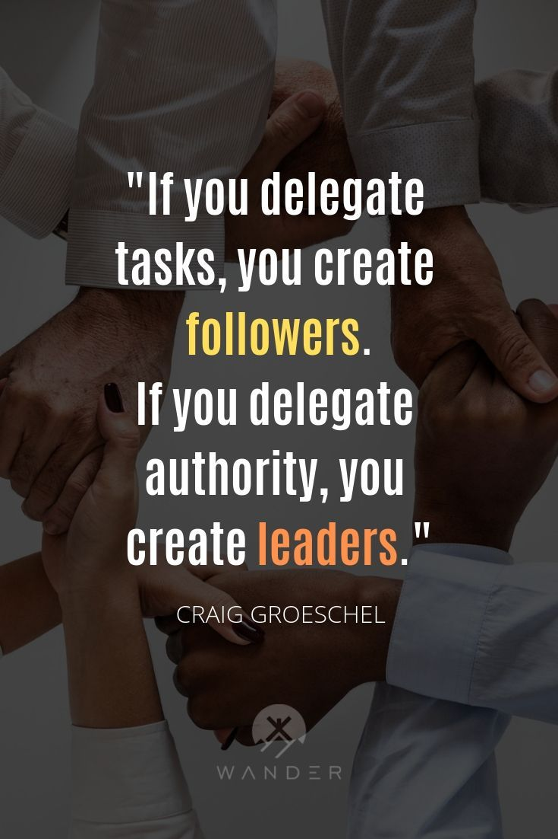

Slide 114
TO EMPOWER them is TO TRUST them

Slide 116
IF you DON’T LET LEADERS LEAD
YOU will LOSE your LEADERS

Slide 118
EQUIP the PEOPLE
EMPOWER the PEOPLE
WORK is accomplished by the PEOPLE

Slide 120
EPHESIANS 4:11-12
¹¹ And he himself gave some to be apostles, some prophets, some evangelists, some pastors and teachers, ¹² to equip the saints for the work of ministry, to build up the body of Christ . . .

Slide 122
TEN ABSOLUTELY ESSENTIAL LESSONS
TO RISE TO THE NEXT LEVEL OF
MINISTRY LEADERSHIP
End Section 3

Slide 124
10 ABSOLUTELY ESSENTIAL LESSONS
TO RISE TO THE NEXT LEVEL OF
MINISTRY LEADERSHIP
Start Section 4

Slide 126
VIII. FOCUS

Slide 128
SERVE in the AREA
of your GREATEST GIFTEDNESS

Slide 130
EXODUS 18:22a-b
They should judge the people at all times.
Then they can bring you every major case
but judge every minor case themselves.

Slide 132
DISTINGUISH what you do BEST
DELEGATE the REST

Slide 134
FOCUS & SIMPIFY

Slide 136
“The Secret of Concentration is Elimination.”
Howard Hendricks

Slide 138
“The less you do,
the more you accomplish.
The less you do,
the more you enable others to accomplish.”
Andy Stanley

Slide 140
IX. EXTEND

Slide 142
EXODUS 18:22c-23
. . . In this way you will lighten your load,
and they will bear it with you. ²³ If you do
this, and God so directs you, you will be able
to endure, and also all these people will be
able to go home satisfied.”

Slide 144
SHARE THE BURDEN

Slide 146
LENGTHEN YOUR LEADERSHIP

Slide 148
ECCLESIASTES 9:9-10, 12b
⁹ Two are better than one because they
have a good reward for their efforts. ¹⁰ For
if either falls, his companion can lift him up;
but pity the one who falls without another to
lift him up . . . A cord of three strands is not
easily broken.

Slide 150
KEEP THE PEACE

Slide 152
X. JUST DO IT

Slide 154
EXODUS 18:24-27
²⁴ Moses listened to his father-in-law and did everything he said. ²⁵ So Moses chose able
men from all Israel and made them leaders
over the people as commanders of thousands, hundreds, fifties, and tens.

Slide 155
²⁶ They judged the people at all times; they
would bring the hard cases to Moses, but they would judge every minor case themselves.
²⁷ Moses let his father-in-law go, and he journeyed to his own land.
EXODUS 18:24-27

Slide 157
IT WILL BE WORTH IT

Slide 159
MAKE THE CHANGES

Slide 161
TEN ABSOLUTELY ESSENTIAL LESSONS
TO RISE TO THE NEXT LEVEL OF
MINISTRY LEADERSHIP
Help for those Overwhelmed in Ministry

Slide 162
I. LISTEN TO OUTSIDE OBJECTIVE OPINIONS
EVERYTHING SHOULDN’T
REVOLVE AROUND YOU
THERE’S ALWAYS ROOM
FOR IMPROVEMENT
IV. STOP TRYING TO DO IT ALONE

Slide 163
EDUCATE – yourself and others
DELEGATE – divide and conquer
EMPOWER – let leaders lead
FOCUS – major on the majors
EXTEND – longevity and harmony
X. JUST DO IT – make the changes

Slide 165
Help for those Overwhelmed in Ministry

