Slide 1
The Preservation of the Quran:
ELF, MMO
May 2025

Slide 2
Muslim Claims 1
Allah has preserved His Book from any alteration, addition, or loss. It is safeguarded until the Day of Judgment.“ (Imam Al-Qurtubi (d. 1273) – Tafsir Al-Jami’ li Ahkam al-Qur’an (15:9)"
"Not a single letter of the Qur’an has been lost, and it remains exactly as revealed to the Prophet Muhammad.“Jalal al-Din al-Suyuti (d. 1505) – Al-Itqan fi ‘Ulum al-Qur'an (Vol. 1, p. 123)
Makkī ibn Abī Tālib (d. 437/1045), ʿIzz al-Dīn ibn ʿAbd al-Salām (d. 660/1262), Ibn Ḥajar al-ʿAsqalānī (d. 852/1449), al-Suyūṭī (d. 911/1505) and al-Qasṭalānī (d. 923/1517), and other Muslim Scholars, claimed that the entire Qur’an was written down during the time of Muhammad.

Slide 3
Claim 2
The Quran that we read today contains the same exact words that were revealed to the Prophet Muhammad (peace be upon him) over 1400 years ago
“The Qur'an is the only inspired scripture that has come down to us intact as revealed to the prophet. There has been no tampering of the text and the original purity of the language has stayed undefiled.” (Introduction to Pickthall's translation with transliteration, (Hyderabad: the Burney Academy), p. xxiv.)

Slide 4
Basis for the Claim of Qur’anic Preservation
The Qur’an says:
Indeed, it is We who sent down the Qur’an and indeed, We will be its Guardian. Qur’an 15:9
Falsehood cannot come to it from before it or behind it (it is) sent down by the All-Wise, Worthy of all praise (Qur’an 41:42].

Slide 5
The Traditional Muslim Narrative
Allah’s Word
Give to Muhammad through Jibril
Over 22 years (610-6132 AD)
Jibril revised it with Muhammad annually
It is
  Clear: It is He who has sent down to you, [O Muhammad], the Book; in it are verses [that are] precise - they are the foundation of the Book - and others unspecific (Qur’an 3:7)
  Arabic: Hebrew and Aramaic content
  Has no contradiction: Naskh
  No errors: Grammar, dates, confusing personalities, anachronisms
  Confirms the previous scriptures. Yet Muslims claim the Bible has been changed.
  A copy of the preserved tablet, al-Lawhu 'l-Mahfuz, kept in heaven.
  Co-eternal with Allah; If Jesus is God’s word….

Slide 6
No Original Copy of the Qur’an.
Contradicts the very essence of preservation.
Islam came with military power.
It had most of the known world’s resources at its disposal.
It ruled most of the world’s centres of learning, and craft.
Would you not expect the original copy of the Qur’an (Muhammad’s copy, Abu Bakr, Uthman’s or al-Hajjaj ibn Yusuf) to have been preserved in a special room/mansion/Palace heavily guarded and maintained.
The degree of Muslim veneration of the Qur’an is dissonant with the lack of an original copy.

Slide 7
Muhammad's scribes
Verses were recorded by Muhamad’s scribes on
  Stones
  Scapulae
  Palm leaves etc
  (Ibn Ishaq, Sirat Rasul Allah, pp. 108-109.)
  Zayd ibn Thabit said: “So I started looking for the Qur’an and collecting it from (what was written on) palmed stalks, thin white stones and also from the men who knew it by heart” (Sahih Bukhari Volume 6, Book 61, Hadith Number 509)
Where were they kept?
They were also committed to memory (Huffaz): issue of trust.
Abdullah ibn Abi Sarh: "Muhammad knows nothing but what I have written for him.“ (Sahih al-Bukhari 3617)

Slide 8
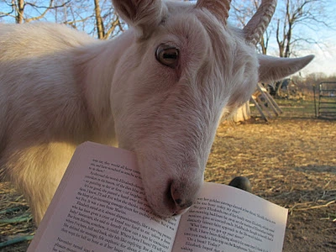
Lost Verses of the Qur’an
According to Aisha, “The Verse of stoning and of breastfeeding an adult ten times was revealed1, and the paper was with me under my pillow. When the Messenger of Allah died, we were preoccupied with his death, and a tame sheep came in and ate it.”
Sunan ibn majah 1944

Slide 9
When Muhammad was Alone?No Scribes
Muhammad was forgetful
"I used to forget a verse that I had received from the Qur'an."(Sahih Bukhari, Volume 6, Book 61, Hadith 533.)
Muhammad would get confused about the order of revelation, which came first etc. (Sahih Muslim, Book 4, Hadith 1748,)

Slide 10
Did Muhammad Collate the Qur’an
"Abu Bakr, after the death of the Prophet and the loss of many Qurra' at Yamamah, decided to collect the Quran in one volume. He summoned Zayd ibn Thabit and tasked him with the project, emphasizing the need to preserve the revelations.“ (Ibn Hisham, The Life of the Prophet Muhammad, pp. 597-600)
“Therefore I suggest, you (Abu Bakr) order that the Qur’an be collected.” I said to ‘Umar, “How can you do something which Allah’s Apostle did not do?” (Sahih Bukhari Volume 6, Book 61, Hadith Number 509.)

Slide 11
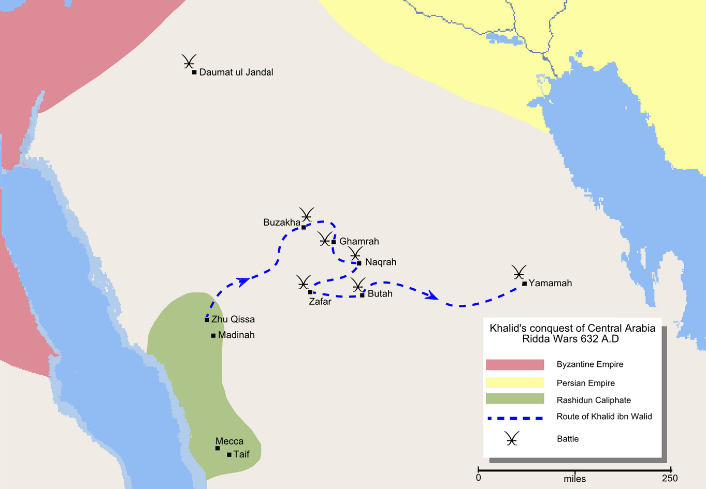
Three Collations/ Recensions of the Qur’an
Abu Bakr, Qurra’ were dying in Battle of Yamamah.
Uthman Ibn Affan: soldiers were fighting over versions.
Al-Hajjaj ibn Yusuf al-Thaqafi: governor of Iraq:
  Introduced vowel diacritics.
  Changed text in 11 places (Ibn Abi Dawud)
  He declared this version to be the only valid one,
  Prohibited the use of Ibn Mas'ud's qira’a
The idea of multiple collations contradicts the concept of preservation.

Slide 12
Crisis of Battle of Yamamah
Death of Qurra’
"When the battle of Yamamah took place, many of the Qurra' were killed. Umar ibn al-Khattab came to Abu Bakr and said, 'The Qurra' have been killed, and I fear that if more of them are killed, a great part of the Quran will be lost.’” (Sahih Bukhari, Volume 5, Book 57, Hadith 61)
"Umar said to Abu Bakr, 'The Qurra' have been killed in great numbers on the day of Yamamah. I fear that if this continues, a large part of the Quran will be lost.’”(Sahih Muslim, Book 4, Hadith 1763)
"In the Battle of Yamamah, more than seventy of the Qurra' were killed, and this was a cause of great concern for the community regarding the preservation of the Quran.“(Ibn Hisham, The Life of the Prophet Muhammad, pp. 597-600)
"The battle resulted in heavy losses among the reciters of the Quran, and it was reported that many of them were killed, which alarmed Abu Bakr and Umar regarding the preservation of the Quran.“ (Al-Tabari, History of the Prophets and Kings, Volume 2, pp. 465-470)

Slide 13
The Bakrite Collation
A committee led by a youth, ? Jewish ? Christian, Zayd ibn Thabit, because he knew Hebrew and Aramaic. (The Life of the Prophet Muhammad), translated by A. Guillaume, pp. 182-183.)
Excluded Muhammad’s most trusted scribes and reciters.
Relied on memory of the Qurra’ who had a tremendous memory.(Ibn Hisham, The Life of the Prophet Muhammad, edited from Ibn Ishaq’s work, pp. 255-256.)
Relied on Muhammad’s Scribes (Ibn Ishaq, Sirat Rasul Allah, pp. 108-10)
“Then the complete manuscripts (copy) of the Qur’an remained with Abu Bakr till he died, then with ‘Umar till the end of his life, and then with Hafsa, the daughter of ‘Umar.” (Sahih Bukhari Volume 6:61:509)

Slide 14
Problems with the Bakrite Collation
Relied on memory of human beings
Memory is inherently imperfect
Muhammad said: "It is a bad thing that some of you say, 'I have forgotten such-and-such verse.' Rather, he has been made to forget it. So, continue to review the Qur'an, for it escapes from people's hearts faster than camels from their ropes.“ (Sahih Muslim 790)
The stoning verse was excluded from the Qur’an even though Muhammad practised stoning. (Sahih Bukhari 6829)
Ubayy ibn Kaʿb (RA) said:"How many verses were there in Surah al-Ahzab?"A Companion replied, "Seventy-three verses."Ubayy responded, "It was equal to Surah al-Baqarah (286 verses), and in it was the verse of stoning.“ (Musnad Ahmad 21895)

Slide 15
The Uthmanic Collation/Medina Standard 650 AD
Hudhaifa bin Al-Yaman came to `Uthman at the time when the people of Sham and the people of Iraq were Waging war to conquer Arminya and Adharbijan. Hudhaifa was afraid of their (the people of Sham and Iraq) differences in the recitation of the Qur'an, … So `Uthman sent a message to Hafsa saying, "Send us the manuscripts of the Qur'an so that we may compile the Qur'anic materials in perfect copies [what was wrong with the first compilation?]and return the manuscripts to you." Hafsa sent it to `Uthman. `Uthman then ordered Zaid bin Thabit, `Abdullah bin AzZubair, Sa`id bin Al-As and `AbdurRahman bin Harith bin Hisham [Why did Uthman exclude the top au thirty on recital, Abdullah ibn Masuud?] to rewrite the manuscripts in perfect copies. `Uthman said to the three Quraishi men, "In case you disagree with Zaid bin Thabit on any point in the Qur'an, then write it in the dialect of Quraish, the Qur'an was revealed in their tongue.“[vs. 7 letters of the Qur’an] They did so, and when they had written many copies, `Uthman returned the original manuscripts to Hafsa.[Where is it?] `Uthman sent to every Muslim province one copy of what they had copied, and ordered that all the other Qur'anic materials, whether written in fragmentary manuscripts or whole copies, be burnt.” [Why do Muslims protest if a non-Muslim burns the Qur’an] (Sahih Bukhari Volume 6, Book 61, Hadith 510)

Slide 16
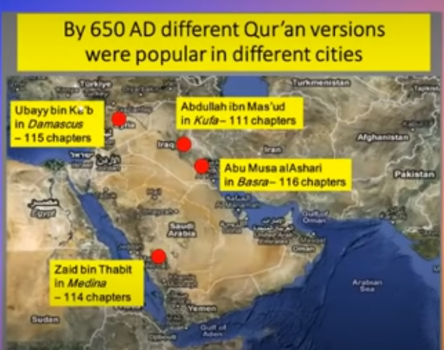

Slide 17
Abdullah Ibn Masud
Muhammad said: Take (learn) the Qur'an from four: Abdullah ibn Mas‘ud, Salim (the freed slave of Abu Hudhaifa), Ubayy ibn Ka‘b, and Mu‘adh ibn Jabal.“(Sahih Bukhari 4999)
Yet Uthman excluded them from the recension committee.
Ibn Masud did nor accept Uthman’s Qur’an: 'O people of Al-'Iraq! Keep the Musahif that are with you, and conceal them. (Jami` at-Tirmidhi 3104)
The people of Kufa (Iraq) supported ibn Masud, and rebelled against Uthman (Kitāb al-Maṣāḥif, ed. Arthur Jeffery, pp. 12-15.)

Slide 18
The Assassination of Uthmaan
Several reasons
Undoubtedly, most importantly, as Muhammad ibn Abi Bakr said to Uthma, “You have altered the Book of Allah” (Alhafidh Ibn Asakir, p.308 –Arabic/ Ibn Kathir, the Beginning and the End, Vol 10, p. 307 Arabic)

Slide 19
The Current Qur’an is Incomplete
Ibn ʿUmar said:"Let none of you say, 'I have taken (all of) the Qur’an.' How does he know what all of it is? Much of the Qur’an has disappeared. Rather, let him say, 'I have taken of it what has appeared (or been preserved).’” [Ibn Abi Dawud, Kitāb al-Maṣāḥif (p. 10-11, Dar al-Basha’ir edition)]
A’isha (RA) said:"Among what was revealed of the Qur'an was: 'Ten definite breastfeedings make a marriage unlawful.' Then it was abrogated by 'Five definite breastfeedings,' and it was recited as part of the Qur’an until the Prophet passed away.“ (Sahih Muslim 1452a)
Ubayy ibn Kaʿb (RA) said:"How many verses were there in Surah al-Ahzab?"A Companion replied, "Seventy-three verses."Ubayy responded, "It was equal to Surah al-Baqarah (286 verses), and in it was the verse of stoning.“ (Musnad Ahmad 5:21895)

Slide 20
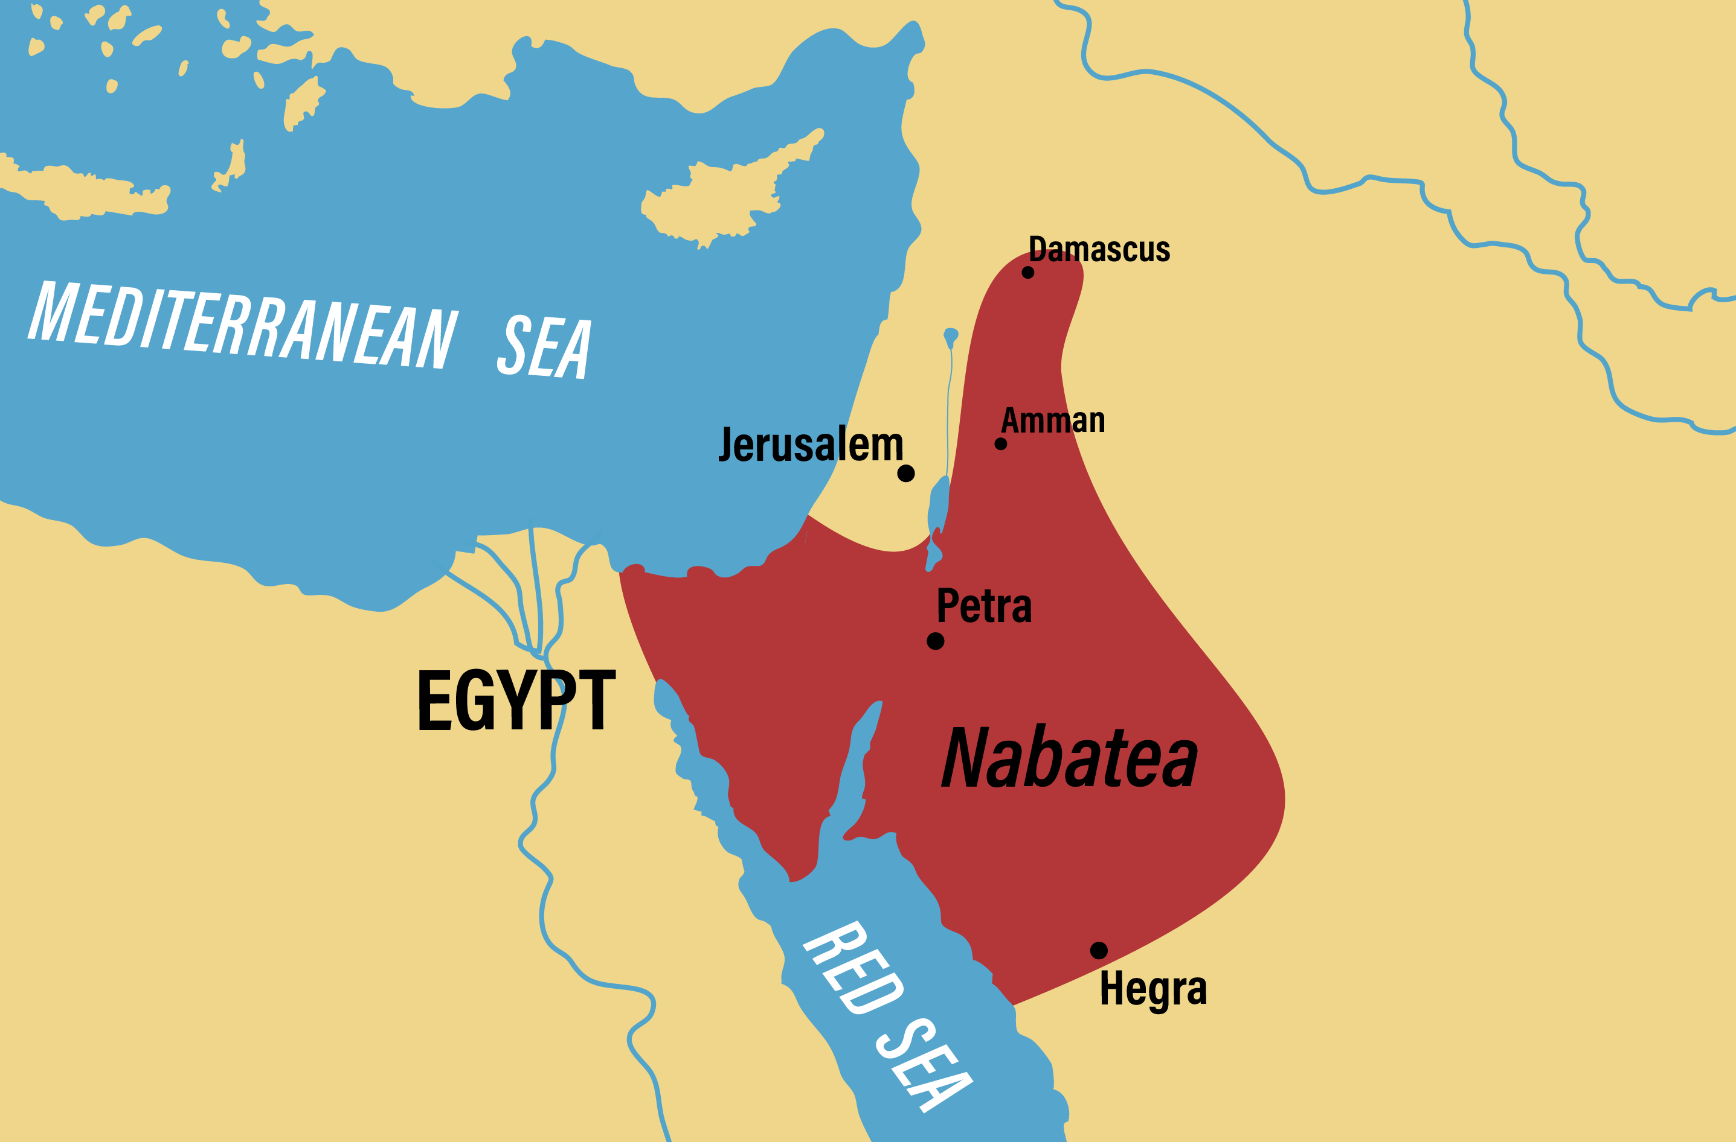
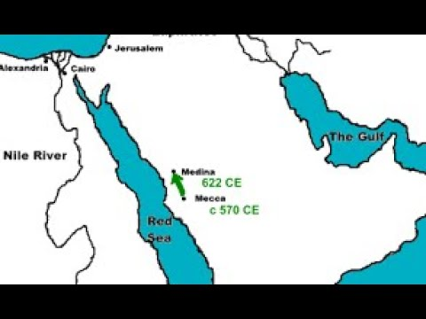
Evolution of the Arabic text
Hijazi/Ma’il/Nabatean
  Based on Aramaic alphabet
  Only 17 consonants
  Pluripotent due to lack of diacritics and pointing.
Kufi: used in Iraq
Sabaean?
  Highly developed Script
  Southern Arabian.
  Yemen and the coast of the Red Sea.
  If Allah wanted to preserve the Qur’an, why did he not send it down in a well developed Arabic script or Sabaeian/South Arabian?

Slide 21
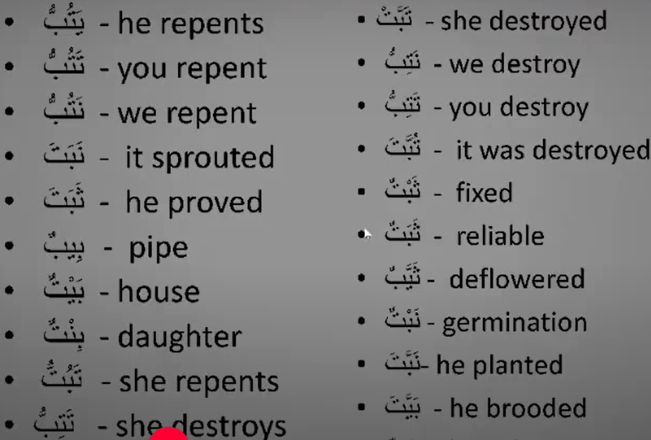
Significance of the diacritics

Slide 22
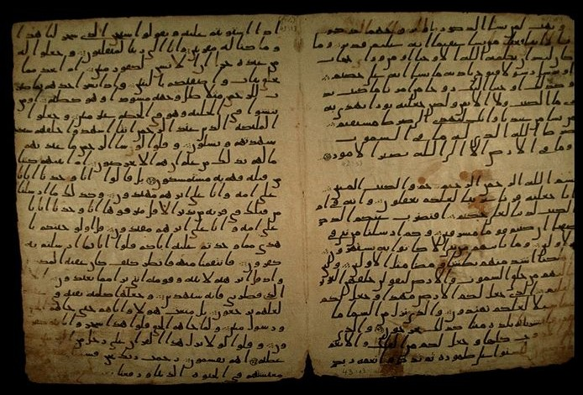
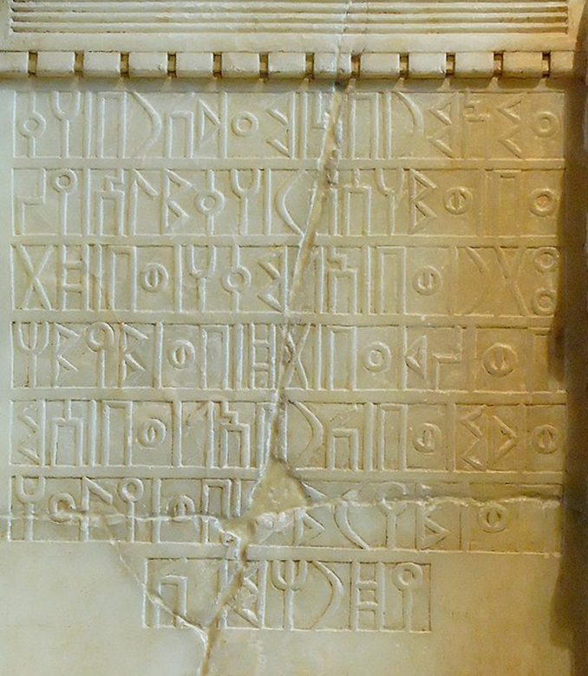
Sitz im Leben of the Qur’an
Setting in life =sociological term which defines the social, cultural, and ethnic context of a specific text, in order to accurately attribute it to a specific time or place.
Qur’anic manuscripts, Hijazi ( Nabatean) then Kufic. Never Sabaean.
Language: more Hebrew and Aramaic.
Description of Mecca
No maps showing Mecca till 8th century.
Places named after Quraysh?
Characters: Biblical
Men of Hadith, all northern, non-Arabs.

Slide 23
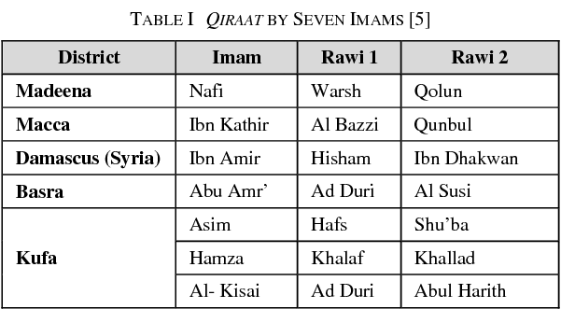
Is the Qur’an unchangeable?

Slide 24
Hence Qira’at
Official readings of the Qur’an developed in in Mecca, Medina, Kufa, Basra, and Damascus.
Formalization of Qira’at:
Abu ‘Amr ibn al-‘Ala’ (d. 770 AD) in Basra
and Nafi‘ al-Madani (d. 785 AD) in Medina
Ibn Mujahid (d. 936 AD) recognised Seven Qirā’āt,
Each Qira’a (reading) developed two Riwayāt (transmissions) (e.g., the Asim Qira’a, came in two Riawayas: Hafs and Warsh)
10th century AD, three more Riwayat were added.
14thand 15th centuries, more Qira’at and Riwayat.
Preservation? What preservation? More like evolution.

Slide 25
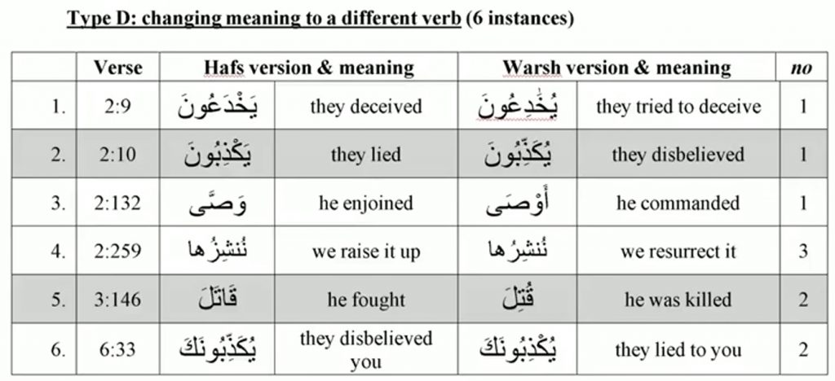
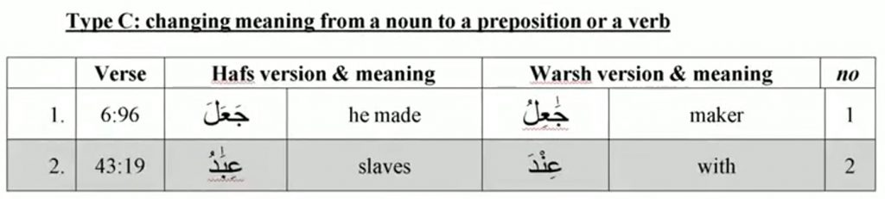
5000 differences between Hafs and Warsh.

Slide 26
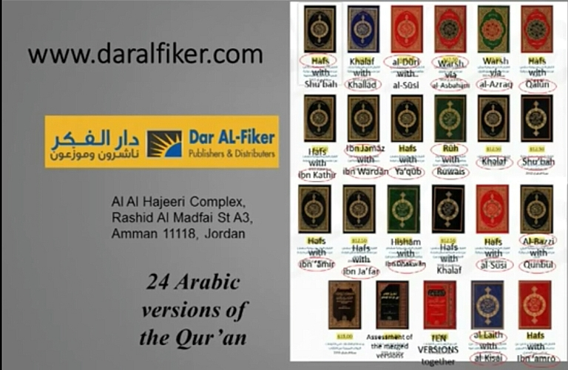

Slide 27
Dilemma
Preservation of the Qur’an means :
"Not a single letter of the Qur’an has been lost, and it remains exactly as revealed to the Prophet Muhammad.“ Jalal al-Din al-Suyuti (d. 1505) – Al-Itqan fi ‘Ulum al-Qur'an (Vol. 1, p. 123)
Al-Suyuti, Ibn al-Jazari, and Al-Qurtubi do not deny letter differences between different Qirā’āt.
"Nay, this is a Glorious Qur’an, in a Preserved Tablet." (Qur’an 85:21-22)
Which of the Qira’at is a copy of the preserved tablet in heave?

Slide 28
The Third Recension/ al-Hajjaj Ibn Yusuf
Introduced pointing and Diacritics to the Qur’anic text.
"Al-Hajjaj ibn Yusuf changed some letters and expressions in the copies of the Qur’an he sent to different regions,” (Al-Suyūṭī (d. 1505) – Al-Itqān fī ʿUlūm al-Qurʾān, Cairo edition, 1880, Vol. 1, p. 274 )
Al-Hajjaj imposed on the people of Iraq a single Qur’anic Qira’ah (Al-Ṭabarī, Tārīkh al-Rusul wa-l-Mulūk, ed. de Goeje, Leiden, 1879–1901, Vol. 6, p. 67. Comports with Ibn Abi Dawud (d. 928) – Kitāb al-Maṣāḥif (The Book of the Qur’anic Codices)

Slide 29
Modifications To the Text of the Qur’an by al-Hajjaj Ibn Abi Dawud's Kitāb al-Maṣāḥif (1936 edition, p. 117-118).
Surah | Before | After
2:259 | لم يتسن | لم يتسنه
3:184 | جاءوا بالبينات والزبر والكتاب المنير | جاءوا بالبينات والزبر والكتاب
9:100 | من تحتها الأنهار | تحتها الأنهار
10:22 | هو الذي يسيركم | ينجيكم
12:45 | أنا أنبئكم بتأويله | أنا أنبئكم بتأويله فَأَرْسِلُونِ
18:83 | يسألونك عن ذي القرنين | يسألونك عن القرنين
23:86 | سبعًا من المثاني | سبعًا
33:6 | النبي أولى بالمؤمنين من أنفسهم وأزواجه أمهاتهم وهو أب لهم | النبي أولى بالمؤمنين من أنفسهم وأزواجه أمهاتهم
34:6 | يرى الذين أوتوا العلم الذي أنزل إليك من ربك هو الحق | يرى الذين أوتوا العلم الذي أنزل إليك من ربك الحق
38:22 | هذا أخي له تسع وتسعون نعجة أنثى | هذا أخي له تسع وتسعون نعجة
48:11 | يقولون بألسنتهم ما ليس في قلوبهم | يقولون بأفواههم ما ليس في قلوبهم

Slide 30
Conflicting Accounts
The Prophet Muhammad said:"This Qur'an has been revealed in seven Aḥruf (modes/dialects), so recite in the way that is easy for you.“ (Sahih al-Bukhari (Hadith 4992, 4993) | Sahih Muslim (Hadith 819)
Does it mean 7 Qira’at?
If so, why do we have many more?
And what of the Dialect of Quraysh?

Slide 31
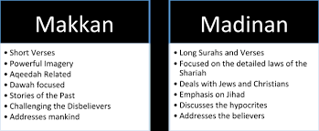
Meccan vs Medinan Surahs.

Slide 32
Most ancient Qur’an
No sentence separators.
No Surah names.
Some were decorated with crosses
Surahs were in a different order:
  Order according to Jibril’s command to Muhammad
  Order is a matter of personal Ijtihad (effort).
No chronological order (see Gospels, The Diatessaron)
Muhammad only named in the Medinan Surahs (4 times only)

Slide 33
Conclusion
Burton finally concludes that the collection process of the Qur’an was a “product of a lengthy process of evolution, accretion, and ‘improvement.’” John Burton, The Collection of the Qurʾān (Cambridge: Cambridge University Press, 1977), 225.

