Slide 1

BETRAYED BY GOD
© Avi Snyder

Slide 2
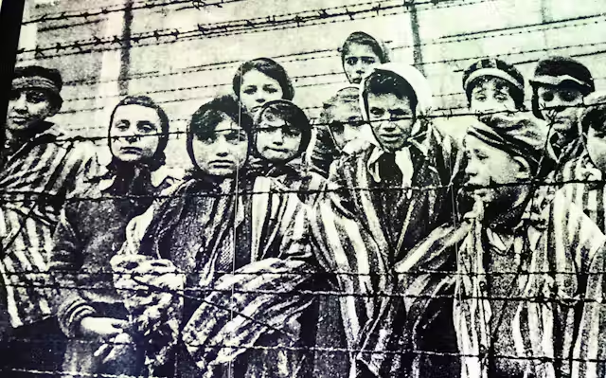
BETRAYED BY GOD
A short story: My friend, Mr. Goldfarb
“Where was God when
the six million
died?”

Slide 3
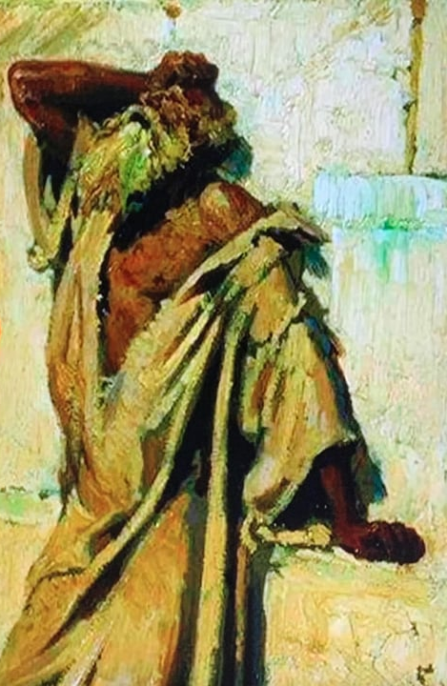
The cry of the prophets
“How long, O Lord, will I cry for help, and You will not hear?” (Habakkuk 1:1)
“How long, O LORD? Will You forget me forever?” (Psalm 13:1)
“My God, my God, why have You forsaken me?” (Psalm 22:1)
The troubling question:
Why is God absent?
Why does He allow all the evil?

Slide 4
Four less-than-satisfying answers
1. He allows the evil because He doesn’t exist
The answer: God allows the evil, because there is no God to stop it
The dilemma:
  If He doesn’t exist, then we shouldn’t be so angry at Him for allowing it
  We’re on our own, and we’re angry at the wind
2. He allows the evil because He is evil
The answer: Our opening premise about God is wrong
He’s not holy, righteous and good – He’s evil
The dilemma: How can we, moral creatures, continue living in a world that’s governed by a malevolent force:
Once again, we’re on our own

Slide 5
Four less-than-satisfying answers
3. He allows the evil because He’s impotent
The answer:
  God is a nice guy, and God is on our side
  But God is powerless to prevent the evil that assails us
The dilemma:
  What use do we have of a God who can do nothing for us?
  Once again, we’re on our own
4. He allows the evil because He’s indifferent
The answer: God allows it because He doesn’t care
The dilemma:
  We should become indifferent as well, but that’s really not possible
  Once again, we’re on our own
The unspeakably frightful dilemma that’s common to all these options: We are alone, with no reason for the calamities that assail us, and no recourse for getting through them.

Slide 6

A more comforting and plausible explanation
God does exist, and we are never alone.
He is holy, righteous, and good.
He has reasons for His seeming silence and absence.
Some of those answers, we can discern and comprehend.
Once the heart has been calmed, then explanations can be offered; for example…

Slide 7

Reasons God allows suffering
He allows the evil in order to capture our attention
Deut. 8:11-14; Prov. 1:25-26
He allows the evil, because we’ve walked away
Psalm 81:12; Rom. 1:24, 26, 28
He allows the evil, because He’s architecting a
greater good
Luke 24:25-26
He allows the evil, because He’s waiting for us to
come to our senses and repent
2 Peter 3:9

Slide 8
Conclusion
Coming back to Mr. Goldfarb
What the death of the 6,000, proves
Contact
Avi Snyder
Jews for Jesus
WhatsApp: +1-423-284-5217
Email: avi.snyder@jewsforjesus.org

