Slide 1
EVANGELISM NETWORK
Sharing our faith in a pandemic
Rico Tice

Slide 2
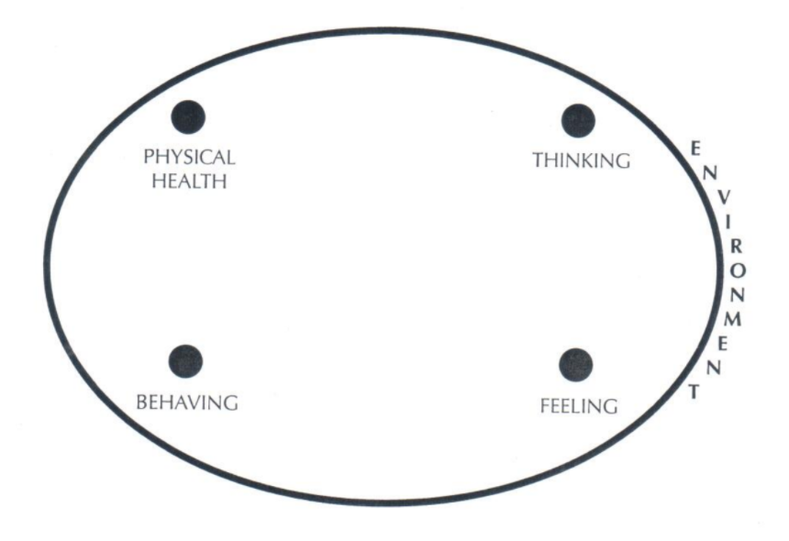
Look in the mirror before you look out the window

Slide 3
How were you converted? 2 Corinthians 4 verse 6
When were you converted? Ephesians 1 verse 4
How does God feel about you? Romans 1 verses 16 & 17
What type of day is today? Romans 8 verse 28
Why is today a better day
than yesterday? 1 Corinthians 2 verse 9

Slide 4
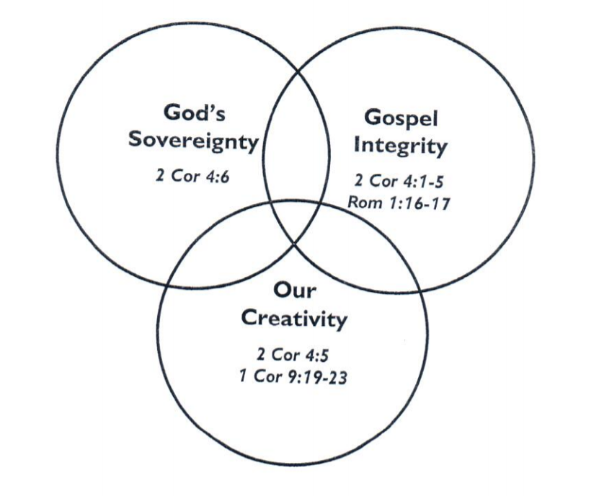

Slide 5
Matthew 7 verses 24 to 27
²⁴ ‘Therefore everyone who hears these words of mine and puts them into practice is like a wise man who built his house on the rock. ²⁵ The rain came down, the streams rose, and the winds blew and beat against that house; yet it did not fall, because it had its foundation on the rock. ²⁶ But everyone who hears these words of mine and does not put them into practice is like a foolish man who built his house on sand. ²⁷ The rain came down, the streams rose, and the winds blew and beat against that house, and it fell with a great crash.’

Slide 6
1. The numbers have taught us about frailty.
2. The cancelled diaries have taught us we’re not in control.
3. The lockdown has taught us we’re relational.

Slide 7
Who are our neighbours?
Acts 17 verses 24 to 28
²⁴ ‘The God who made the world and everything in it is the Lord of heaven and earth and does not live in temples built by human hands. ²⁵ And he is not served by human hands, as if he needed anything. Rather, he himself gives everyone life and breath and everything else. ²⁶ From one man he made all the nations, that they should inhabit the whole earth; and he marked out their appointed times in history and the boundaries of their lands. ²⁷ God did this so that they would seek him and perhaps reach out for him and find him, though he is not far from any one of us. ²⁸ “For in him we live and move and have our being.” As some of your own poets have said, “We are his offspring.”

Slide 8
Adapted from Sam Chan’s post-COVID playbook:
https://plus.citybibleforum.org/collection/1739

Slide 9
Interests

Slide 10
Interests
Values/
emotions

Slide 11
Interests
Values/
emotions
World- views

Slide 12
Layer 1 - My presented life
Layer 2 - My feelings and emotions
Layer 3 - My worldview

