Slide 1
Why Strategic Plans Fail
. . . and what can you do about it

Slide 2
Introduction
The Prevailing Need—Organizations clearly understand that in order to grow they must plan for the future
The Success Rate of Strategic Plans—Unfortunately, however, 90% of all strategic plans fail
The Problem-–A failed plan ultimately results in the loss of confidence of constituents it is committed to serve

Slide 3
Why Plans Fail
Too Often Created in a Vacuum—Creating unrealistic goals given available resources
Including the Wrong People—Those who are the first to volunteer are often those who have a “hidden agenda”
Lack of Specificity—Big ideas need to be narrowed down to measurable and quantifiable objectives
Lack of Accountability—There is often not a clearly defined time agenda to which participants are accountable
Failure to Engage the Input of Others—In areas of planning that go beyond the expertise of the planning team

Slide 4
The Big Picture
Vision
The Strategic Plan
The Development Plan
Mission

Slide 5
Four Characteristics of Highly Successful Organizations
Mission—Highly successful organizations have a mission statement that states in quantifiable terms their mission and purpose. A mission statement will typically include a series of clauses that clarify their mission and how they intend to fulfill it
Vision—These same organization have a clear vision of what this mission statement would look like if it were successfully accomplished
Strategic Planning—The successful strategic plan spells out in quantifiable terms over a relatively short amount of time the steps they are going to take to achieve their plan
Development Plan—The organizational development plan outlines in quantifiable terms the resources that will be required to achieve these annual goals

Slide 6
The Attitude Continuum

Slide 7
Planning Initiatives
Organizational Mission—Your mission is the foundation of all planning and strategic planning begins here
Strategic Initiatives—Your planning must focus on identifying key initiatives; every strategic plan is different. Preliminary planning typically identifies 5-7 key initiatives
Key Initiatives—Here are some examples:
Facilities
Curriculum
Co-Curricular Activities
Personnel
Athletics

Slide 8
Mind Mapping
Mind Mapping—The majority of organizations use some form of mapping plans for the future
Resources—There are several mind managing software tools available
Suggestion—My preference is X-Mind. It is free and available online at: www.xmind.net
Sharing Maps—For those who want to share a map with others, X-Mind provides a small fee that enables you to share maps with others
Samples—X-Mind provides a wide range of creative maps. Here’s one …

Slide 9
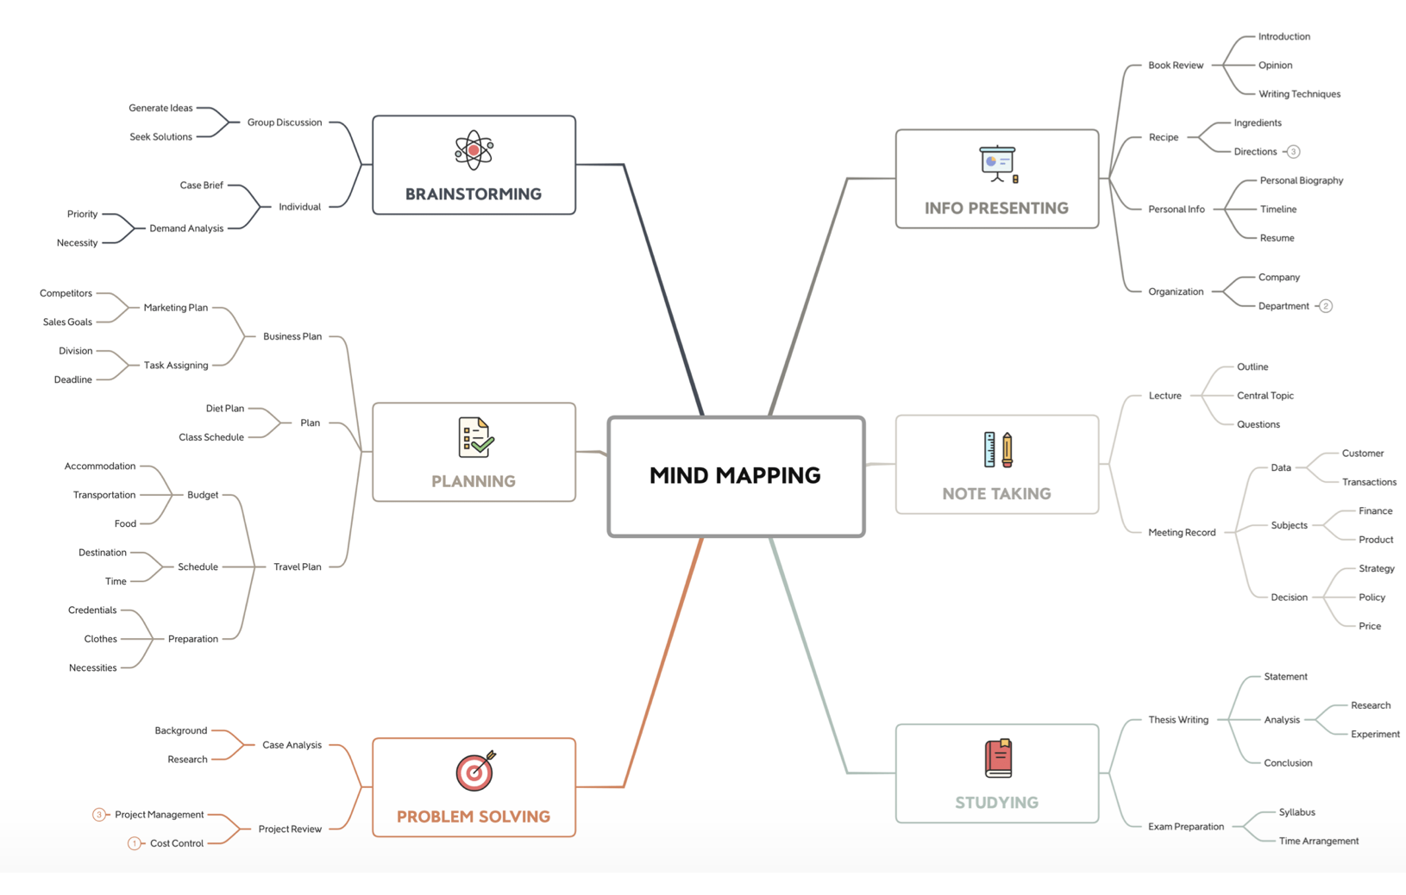
A Sample Mind Map

Slide 10
The Strategic Planning Model Eight Steps
Profile the Ideal—Imagine perfection and what it looks like
Assessment—Based on a scale from A-D, how would you assess where you are now?
Quantify—From the list above, create a list of deficiencies that come to mind
Prioritize—Take the same list and prioritize the deficiencies
Planning—Begin creating plans to address needs
Organize—Begin creating plans to address needs
Implement–Engage teams to address specific needs
Evaluate—How well did you do? Start all over again!

Slide 11
The Practicality Factor
Always be Planning—The idea of planning is not limited to major organizational planning events
Plan Everything!—It takes a few minutes to create a preliminary plan, for anything!
Sample Ideas—Here are several ideas that should be considered:
Plan Events
Plan Special Programs and Activities
Plan Meetings, plan a presentation, plan a sermon
Plan family get togethers and small group meetings
Plan your week, your personal goals, and aspirations

Slide 12
Dream
Dream—Take time, regularly, to imagine great thoughts and opportunities
The Box—Many people live in a box without clearly understanding what’s outside of that box. Listen respectfully to what others have to say and occasionally suggest options
Ask Questions—Suggest ideas regardless of how absurd they might appear
LISTEN—Quietly and considerately take the time to listen to others

